Slide 1
THE LEADER IN TODAY’S NON-QM PROGRAMS
acralending.com

Slide 2
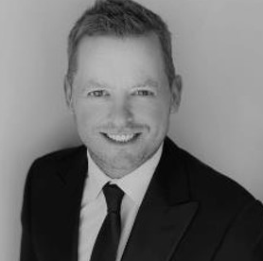
MEET THE TEAM
acralending.com
STEVE CUTTER
Senior Vice President
c: (714) 595-4114
e: steve.cutter@acralending.com
w: acralending.com
RYAN BARRUS
Senior Vice Presidemt
c: (801) 471-7926
e: ryan.barrus@acralending.com
w: acralending.com

Slide 3
CORPORATE HISTORY
acralending.com
CSC formed as a sister company to service for First Street Financial, Inc
CSC re-enters the mortgage origination market, specializing in Non-QM loans
Funds managed by HPS Partners purchased CSC
CSC rebranded to Acra Lending
Exceeds $10B in Fundings
2003
2013
2020
2021
2023
KEY FACTS
LEADERSHIP
Leadership team made up of industry professionals with over 40+ years of experience
$10B+ in fundings to date
$5B+ servicing portfolio
Licensed in 40+ states
KEITH LIND CEO | KYLE GUNDERLOCK President & CRO | MIKE KOVAR CFO & Treasurer
GREGORY MEOLA Managing Director | JEFFREY LEMIEUX Managing Director | CRAIG TIMMINS Managing Director
ERIC FRIEDMAN Managing Director | SCOTT SPENCER Manager Director

Slide 4
NATIONAL PRESENCE WITH LOCAL SERVICE
acralending.com
Clackamas, OR
West Hartford, CT
Lehi, UT
Las Vegas, NV
Missouri, MO
Corporate HQ in Orange County, CA
Scottsdale, AZ
Atlanta, GA
Clearwater, FL
Honolulu, HI
Ability to grow your business nationally. Business Purpose Loans in 32 states that do not require licensure

Slide 5
CONTENTS
acralending.com
Full Program Overview
Resources
Questions

Slide 6
FULL PROGRAM OVERVIEW
acralending.com

Slide 7
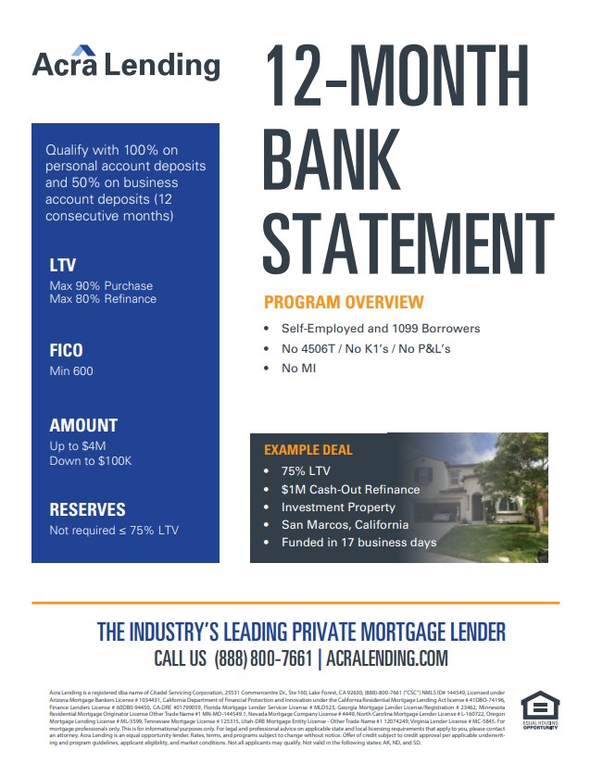
12-MONTH BANK STATEMENT
12-MONTH BANK STATEMENT
ATR-IN-FULL
PROGRAM HIGHLIGHTS
Self-Employed & 1099 Borrowers
Qualify with 100% on personal account deposits and 50% on business account deposits (12 consecutive months)
Loan amounts up to $4M (case-by-case $10M)
Max 90% LTV Purchase
Max 80% LTV Refinance
Min 600 FICO
No reserves required at 75% LTV or below
No 4506T / No K1’s / No P&L’s
No MI

Slide 8
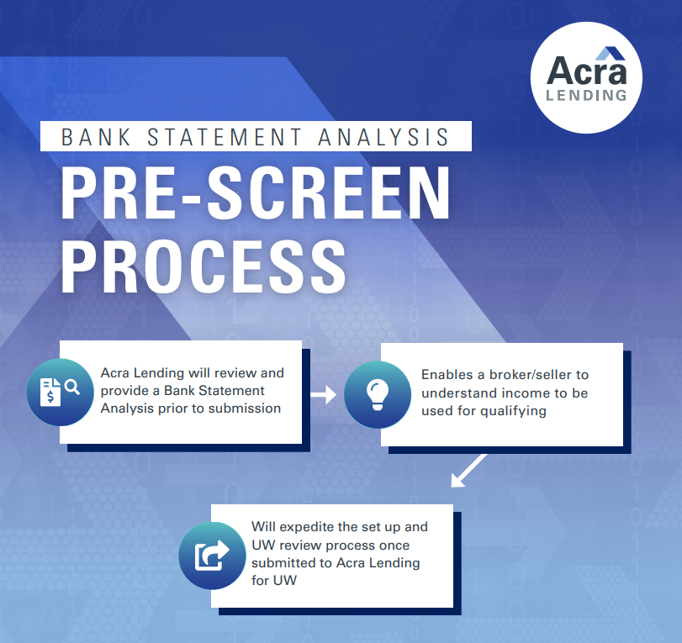
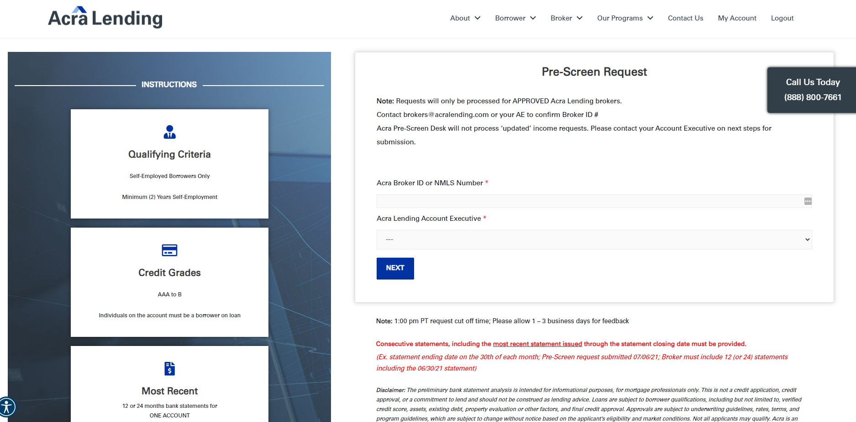
BANK STATEMENT ANALYSIS
BANK STATEMENT ANALYSIS
ATR-IN-FULL

Slide 9
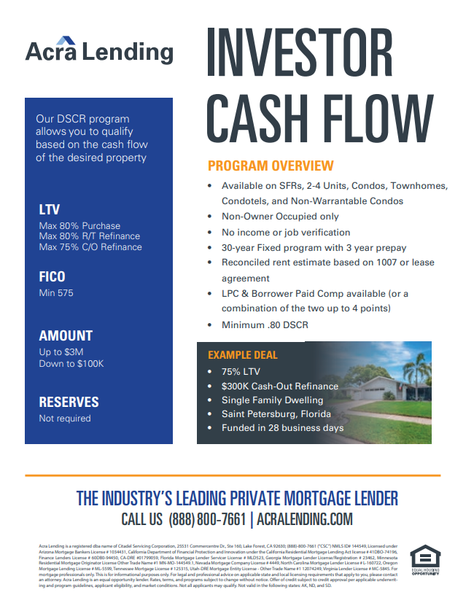
DSCR - INVESTOR CASH FLOW
INVESTOR CASH FLOW
ATR-IN-FULL
PROGRAM HIGHLIGHTS
Qualify solely off subject property rents (Rents/PITI) - DSCR ratio down to .80
No income or employment verification
Available on SFRs, 2-4 Units, Condos, Townhomes, Condotels, and Non-Warrantable Condos
Loan amounts up to $3M
Investment properties only
No reserves required
5yr & 10yr I/O options available (Use I/O payment for DSCR ratio)
Purchases - Use the rent survey on appraisal for DSCR ratio

Slide 10
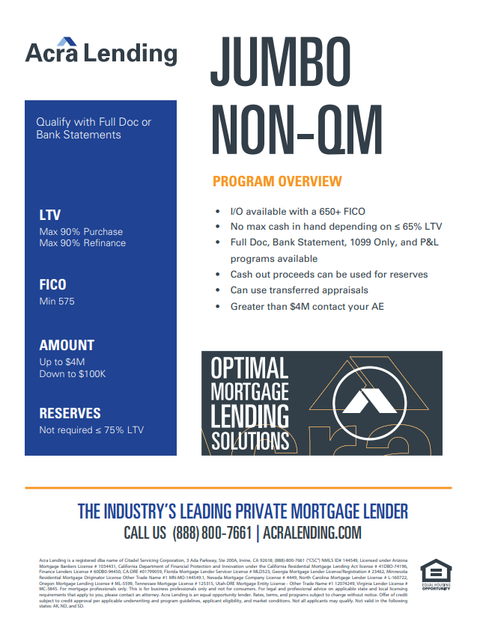
JUMBO NON-QM
ATR-IN-FULL
PROGRAM HIGHLIGHTS
Loan amounts up to $10M, Owner Occ / $3M Investment
Qualify with Full Doc, Bank Statements, DSCR, ATR-In-Full
I/O available with a 650+ FICO
C/O available with no max cash in hand at 65% LTV or below

Slide 11
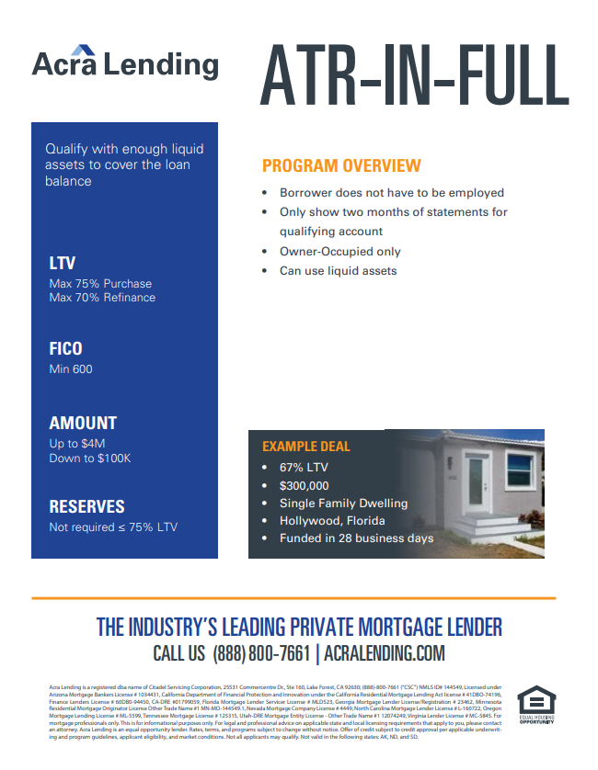
ATR-IN-FULL
ATR-IN-FULL
PROGRAM HIGHLIGHTS
Qualify with a liquid asset that is equal to or greater than the requested loan amount
Borrower does not have to be currently employed
Only show 2 months of statements for qualifying account (Brokerage Accounts, Retirement Accounts, Savings, etc.)
Min 600 FICO
Max 75% LTV Purchase
Max 70% LTV Refinance
Owner-Occupied Only

Slide 12
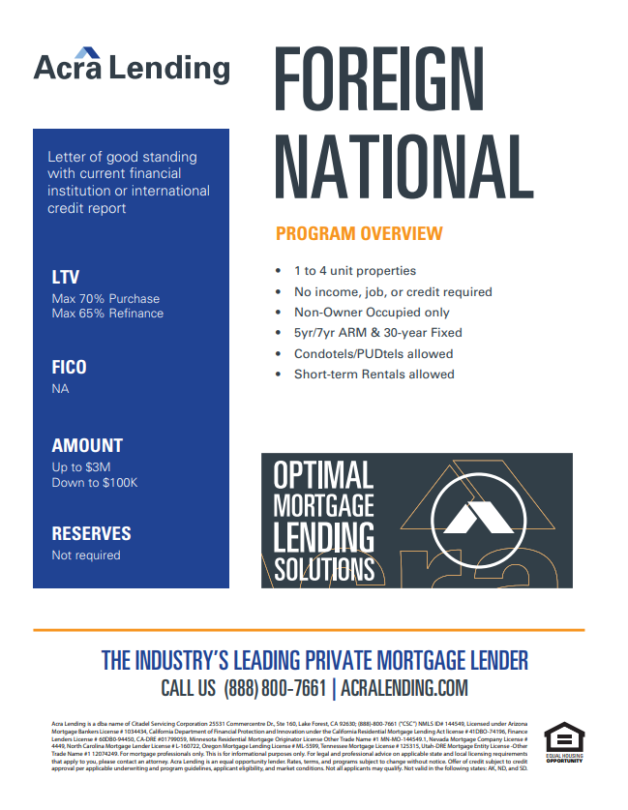
FOREIGN NATIONAL
FOREIGN NATIONAL
ATR-IN-FULL
PROGRAM HIGHLIGHTS
Designed for borrowers who live and work outside of the U.S. and are looking to purchase or refinance an investment property here
No income, job, or credit required
No reserves
Non-Owner Occupied Only
30-Year Fixed, 5yr & 10yr I/O available
Max 70% LTV Purchase
Max 65% LTV Refinance
Most property types allowed

Slide 13
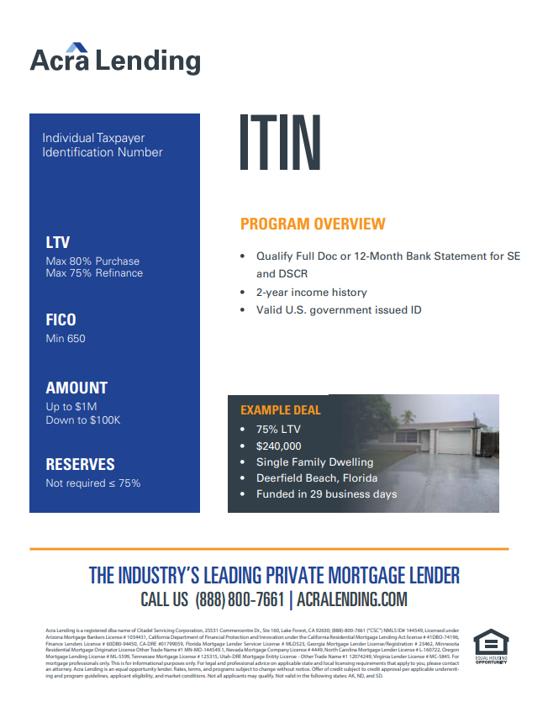
ITIN
PROGRAM HIGHLIGHTS
Income programs: WVOE for Wage Earners, 12-Month Bank Statement for Self-Employed, DSCR available for NOO
2-year income history
Valid U.S. government issued ID or U.S. Passport
Max 80% LTV
Loan amounts up to $1M
Min 650 FICO

Slide 14
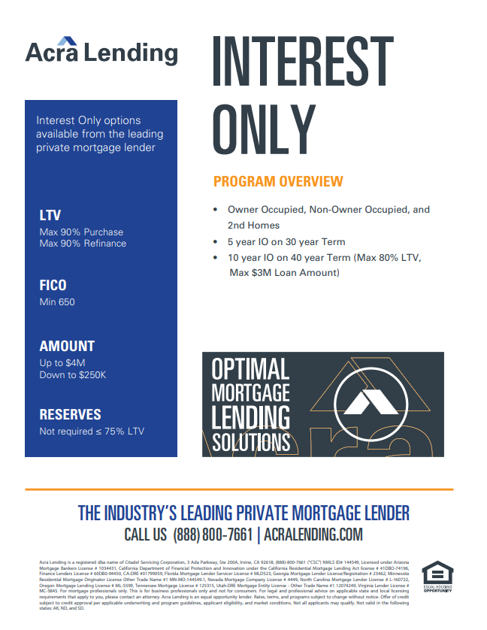
INTEREST ONLY
PROGRAM HIGHLIGHTS
Min 650 FICO
Loan amounts up to $4M (O/O)
Loan amounts down to $250K
Owner Occupied, Non-Owner Occupied, and 2nd Homes
Max 90% LTV
DSCR calculation based off Interest Only payment rather than full P&I
5-Year I/O 30-Year term available on 5/1 & 7/1 ARMs
10-Year I/O 40-Year term with 30-Year Fixed

Slide 15
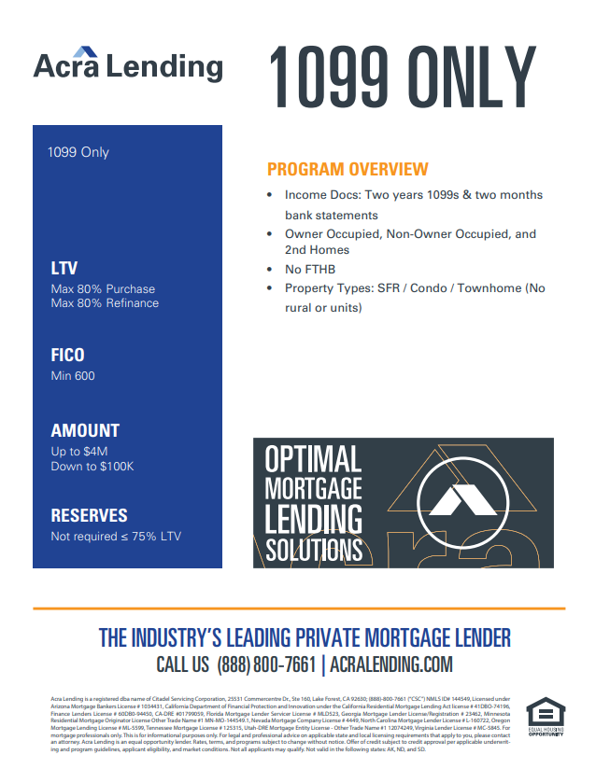
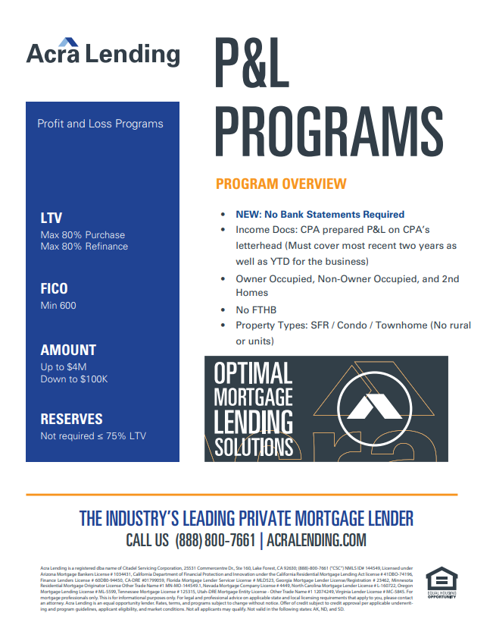
1099 ONLY AND P&L PROGRAMS
PROGRAM HIGHLIGHTS
Great for SE borrowers who have a business expense ratio below 25%
P&L Only: CPA prepared P&L covering most recent 2 years and YTD (No bank statements needed)
1099 Only: Most recent 2 years 1099s + Most recent 2 months Bank Statements for YTD
Max 80% LTV
Min 600 FICO
No First-Time Home Buyers
No rural or multi-units
Min 24-month recent mortgage history

Slide 16
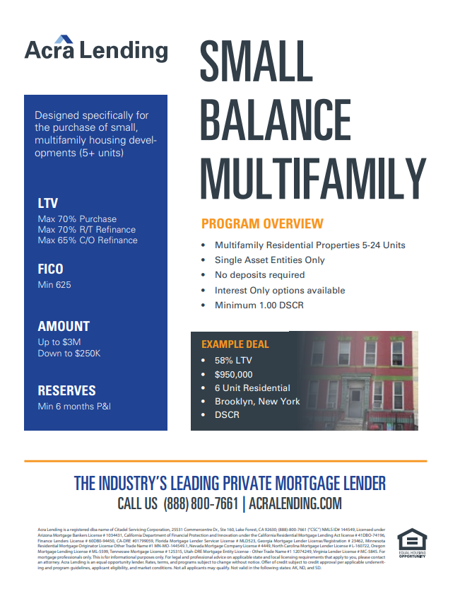
SMALL BALANCE MULTIFAMILY
ATR-IN-FULL
PROGRAM HIGHLIGHTS
Qualifies solely off DSCR (No income or employment verification)
Min DSCR 1.00
Min 625 FICO
Loan amounts up to $3M
Loan amounts down to $250K
Multifamily Residential Properties 5-24 Units
Single Asset Entities Only
Interest Only options available
Min 6-month P&I in reserves

Slide 17
NICHE’S
BORROWERS WHO DON’T FIT THE RIGID QM MOLD
Short-Term Rentals (DSCR)
Condotels
Non-Warrantable Condos
Adult Care Facilities (including sober living properties)
Rural properties and up to 25 acres
Multifamily up to 24-Units
Jumbo’s up to $10M
Borrowers with recent credit events (Foreclosure, Bankruptcy, Short Sale, Forbearance)
Min 575 FICO

Slide 18
RESOURCES
acralending.com
Let’s start with the first set of slides

Slide 19
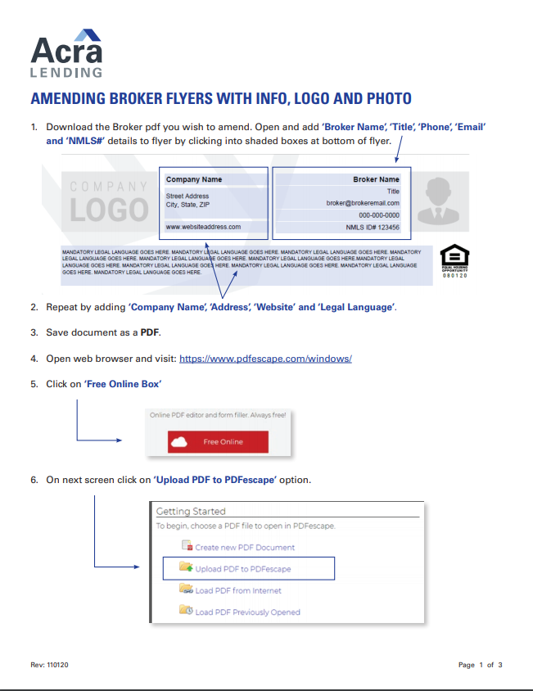
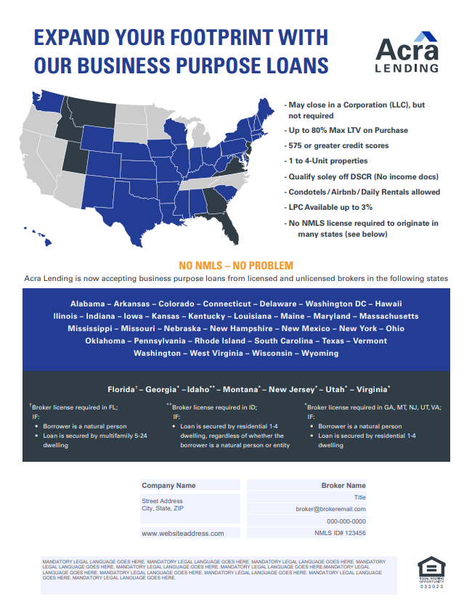
BROKER MARKETING COLLATERAL
acralending.com
ATR-IN-FULL
CUSTOMIZABLE MARKETING COLLATERAL AVAILABLE FOR APPROVED BROKERS

Slide 20
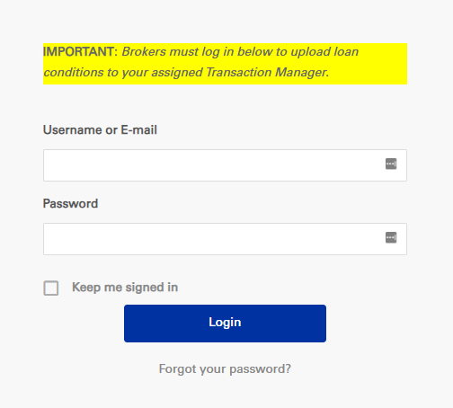
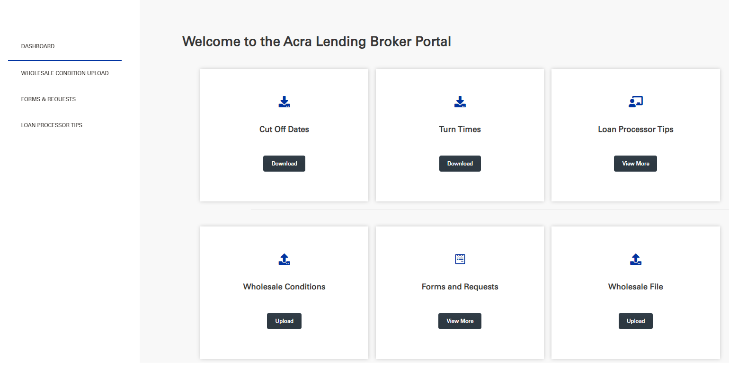
BROKER PORTAL
acralending.com
ATR-IN-FULL

Slide 21
QUESTIONS?
acralending.com
Let’s start with the first set of slides

Slide 22
CONTACT US
acralending.com
STEVE CUTTER
Senior Vice President
c: (714) 595-4114
e: steve.cutter@acralending.com
w: acralending.com
RYAN BARRUS
Senior Vice Presidemt
c: (801) 471-7926
e: ryan.barrus@acralending.com
w: acralending.com

