Slide 1
THE LEADER IN TODAY’S NON-QM PROGRAMS

Slide 2
HOW TO SOURCE NON-QM BUSINESS

Slide 3
DISCLAIMER
Acra Lending is a registered dba name of Citadel Servicing Corporation, 3 Ada Parkway, Ste 200A, Irvine, CA 92618; (888)-800-7661 (“CSC”) NMLS ID 144549. Acra Lending operates in 41 states and the District of Columnbia: Alabama Consumer Credit License # 22078, Arizona Mortgage Bankers License # 1034431, Arkansas Combination Mortgage Banker-Broker-Servicer License # 109106, Licensed by the Department of Business Oversight under the California Residential Mortgage Lending Act. California – Department of Financial Protection and Innovation Financing Law License # 60DBO94450, California – Department of Financial Protection and Innovation Residential Mortgage Lending Act License # 41DBO-74196, California - DRE Real Estate Corporation License Endorsement License # 01799059, Colorado Mortgage Company Registration, Connecticut Mortgage Lender License # ML-144549, Delaware Lender License # 20322, District of Columbia Mortgage Lender License # MLB144549, Florida Mortgage Lender Servicer License # MLD523, Georgia Mortgage Lender License/Registration # 23462, Hawaii Mortgage Loan Originator License # HI-144549, Idaho, Illinois Residential Mortgage License # MB.6761204, Indiana-DFI Mortgage Lending License # 30531, Kansas Mortgage Company License # MC.0025274, Kentucky Mortgage Company License # MC327787, Louisiana Residential Mortgage Lending License, Maine Supervised Lender License # 144549, Maryland Mortgage Lender License # 144549, Michigan 1st Mortgage Broker/Lender/Servicer License # FL0020685, Minnesota Residential Mortgage Originator License Other Trade Name #1 MN-MO-144549.1, Missouri Mortgage Company License # 144549, Montana Mortgage Lender License # 144549, Nebraska Mortgage Banker License, Nevada Mortgage Company License # 4449, New Hampshire Mortgage Banker License # 21139-MB, New Jersey Residential Mortgage Lender License, New Mexico Mortgage Loan Company License, North Carolina Mortgage Lender License # L-160722, Ohio Residential Mortgage Lending Act Certificate of Registration RM.804651.000, Oklahoma Mortgage Lender License - Other Trade Name #1 ML013105, Oregon Mortgage Lending License # ML-5599, Pennsylvania Mortgage Lender License # 51804, South Carolina-BFI Mortgage Lender/Servicer License - Other Trade Name #1 MLS - 144549 OTN #1, Tennessee Mortgage License # 125315, Texas - SML Mortgage Company License, Utah-DRE Mortgage Entity License - Other Trade Name #1 12074249, Vermont Lender License - Other Trade Name #1 7601, Virginia Lender License # MC-5845, Washington Consumer Loan Company License # CL-144549, Wisconsin Mortgage Banker License # 144549BA, Wyoming Mortgage Lender/Broker License # 3781. This is intended for business professionals only. Acra Lending is an equal opportunity lender. Rates, terms, conditions, and programs are subject to change without notice. Offer of credit subject to credit approval per applicable underwriting and program guidelines, applicant eligibility, and market conditions. Not all applicants may qualify. Restrictions may apply. Not valid in the following states AK, IA, MA, MS, NY, ND, RI, SD, and WV

Slide 4
MEET THE TEAM
JOE TOMASELLO
Senior Vice President
C: (559) 352-5156
E: joe.tomasello@acralending.com
W: acralending.com
ADAM MORRIS
Senior Vice President
C: (949) 656-3771
E: adam.morris@acralending.com
W: acralending.com

Slide 5
CONTENTS
CONSUMER LOANS
BUSINESS PURPOSE LOANS
MAP: NON-LICENSED LOAN ORIGINATION STATES
INVESTOR LOAN DIVISION
BROKER MARKETING COLLATERAL
QUESTIONS

Slide 6
CONSUMER LOANS
CONSUMER LOANS
Direct clients or referral source opportunities for Non-QM consumer loans are:
Realtors
CPA’s / Tax Preparers
Wealth Advisors
Trust Attorneys
Title Reps
Adult Care Facility Industry
Assisted Living Facility Industry
Bank + Credit Union Turndowns
Insurance Brokers
Data Brokers / Lead Providers
Business Bankers
Self-Employed Trade Hubs

Slide 7
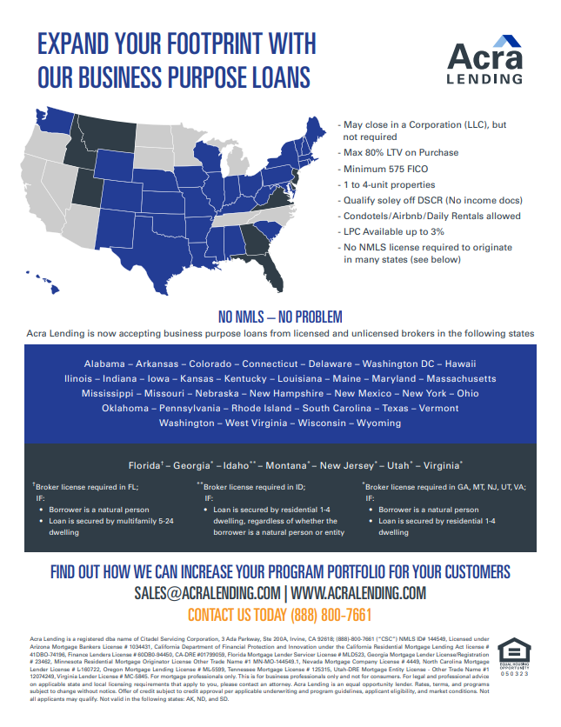
DSCR - INVESTOR CASH FLOW
BUSINESS PURPOSE LOANS
ATR-IN-FULL
Direct client or referral source opportunities for Business Purpose loans are:
Realtors
Banks + Credit Unions
Hard Money Lenders
Real Estate Investment Groups
Contractors
Adult Care Facility Owners
Assisted Living Facility Owners
Foreign Investor Groups

Slide 8
DSCR - INVESTOR CASH FLOW
INVESTOR LOAN DIVISION
ATR-IN-FULL
Direct client or referral source opportunities for the Investor Loan Division are:
Direct Property Investors (Professional & Passive)
Contractors
Auctions
Local / Regional Bank Turndowns
Non-QM only Lender Turndowns
Credit Union Turndowns

Slide 9
DSCR - INVESTOR CASH FLOW
LOAN SCENARIOS
ATR-IN-FULL
Typical Loan Scenarios Currently being Submitted
Borrowers who need to refinance out of hard money
Borrowers who need to refinance out of construction loans
Multifamily (5-24 units)
ITIN Borrowers
No Ratio DSCR
No Score/One Score
Investors in multiple states

Slide 10
Poll Question
You can originate Business Purpose loans in some states without an NMLS license, True or False?

Slide 11
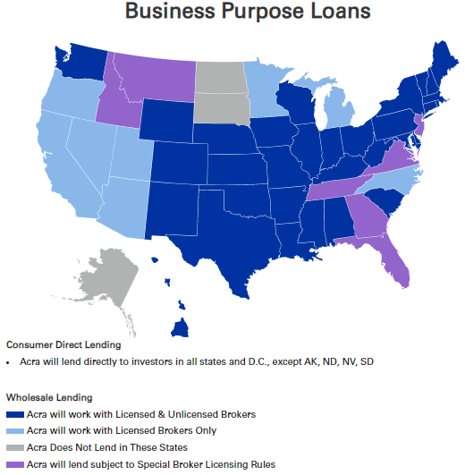
BUSINESS PURPOSE: NON-LICENSED STATES
BUSINESS PURPOSE: NON-LICENSED STATES
Business Purpose loans (Non-TRID) can be originated in 33 states without NMLS licensing from the Broker or Loan Officer. Allowed for DSCR, Bridge, Fix & Flip, Blanket Portfolio, and Multi-Family properties that close in an entity.
Alabama
Arkansas
Colorado
Connecticut
Delaware
Dist. of Columbia
Hawaii
Illinois
Indiana
Iowa
Kansas
Kentucky
Louisiana
Maine
Maryland
Massachusetts
Mississippi
Missouri
Nebraska
New Hampshire
New Mexico
New York
Ohio
Oklahoma
Pennsylvania
Rhode Island
South Carolina
Texas
Vermont
Washington
West Virginia
Wisconsin
Wyoming

Slide 12
QUESTIONS?
Let’s start with the first set of slides

Slide 13
CONTACT US
JOE TOMASELLO
Senior Vice President
C: (559) 352-5156
E: joe.tomasello@acralending.com
W: acralending.com
ADAM MORRIS
Senior Vice President
C: (949) 656-3771
E: adam.morris@acralending.com
W: acralending.com
Acra Lending is a registered dba name of Citadel Servicing Corporation, 3 Ada Parkway, Ste 200A, Irvine, CA 92618; (888)-800-7661 (“CSC”) NMLS ID# 144549, Licensed under Arizona Mortgage Bankers License # 1034431, California Department of Financial Protection and Innovation under the California Residential Mortgage Lending Act license # 41DBO-74196, Finance Lenders License # 60DB0-94450, CA-DRE #01799059, Florida Mortgage Lender Servicer License # MLD523, Georgia Mortgage Lender License/Registration # 23462, Minnesota Residential Mortgage Originator License Other Trade Name #1 MN-MO-144549.1, Nevada Mortgage Company License # 4449, North Carolina Mortgage Lender License # L-160722, Oregon Mortgage Lending License # ML-5599, Tennessee Mortgage License # 125315, Utah-DRE Mortgage Entity License - Other Trade Name #1 12074249, Virginia Lender License # MC-5845. For mortgage professionals only. This is for business professionals only and not for consumers. For legal and professional advice on applicable state and local licensing requirements that apply to you, please contact an attorney. Acra Lending is an equal opportunity lender. Rates, terms, and programs subject to change without notice. Oer of credit subject to credit approval per applicable underwriting and program guidelines, applicant eligibility, and market conditions. Not all applicants may qualify. Not valid in the following states: AK, ND, and SD

