Slide 1
THE LEADER IN TODAY’S NON-QM PROGRAMS

Slide 2
SELF-EMPLOYED, INVESTORS & FOREIGN NATIONAL BORROWERS

Slide 3
DISCLAIMER
Acra Lending is a registered dba name of Citadel Servicing Corporation, 3 Ada Parkway, Ste 200A, Irvine, CA 92618; (888)-800-7661 (“CSC”) NMLS ID 144549. Acra Lending operates in 41 states and the District of Columnbia: Alabama Consumer Credit License # 22078, Arizona Mortgage Bankers License # 1034431, Arkansas Combination Mortgage Banker-Broker-Servicer License # 109106, Licensed by the Department of Business Oversight under the California Residential Mortgage Lending Act. California – Department of Financial Protection and Innovation Financing Law License # 60DBO94450, California – Department of Financial Protection and Innovation Residential Mortgage Lending Act License # 41DBO-74196, California - DRE Real Estate Corporation License Endorsement License # 01799059, Colorado Mortgage Company Registration, Connecticut Mortgage Lender License # ML-144549, Delaware Lender License # 20322, District of Columbia Mortgage Lender License # MLB144549, Florida Mortgage Lender Servicer License # MLD523, Georgia Mortgage Lender License/Registration # 23462, Hawaii Mortgage Loan Originator License # HI-144549, Idaho, Illinois Residential Mortgage License # MB.6761204, Indiana-DFI Mortgage Lending License # 30531, Kansas Mortgage Company License # MC.0025274, Kentucky Mortgage Company License # MC327787, Louisiana Residential Mortgage Lending License, Maine Supervised Lender License # 144549, Maryland Mortgage Lender License # 144549, Michigan 1st Mortgage Broker/Lender/Servicer License # FL0020685, Minnesota Residential Mortgage Originator License Other Trade Name #1 MN-MO-144549.1, Missouri Mortgage Company License # 144549, Montana Mortgage Lender License # 144549, Nebraska Mortgage Banker License, Nevada Mortgage Company License # 4449, New Hampshire Mortgage Banker License # 21139-MB, New Jersey Residential Mortgage Lender License, New Mexico Mortgage Loan Company License, North Carolina Mortgage Lender License # L-160722, Ohio Residential Mortgage Lending Act Certificate of Registration RM.804651.000, Oklahoma Mortgage Lender License - Other Trade Name #1 ML013105, Oregon Mortgage Lending License # ML-5599, Pennsylvania Mortgage Lender License # 51804, South Carolina-BFI Mortgage Lender/Servicer License - Other Trade Name #1 MLS - 144549 OTN #1, Tennessee Mortgage License # 125315, Texas - SML Mortgage Company License, Utah-DRE Mortgage Entity License - Other Trade Name #1 12074249, Vermont Lender License - Other Trade Name #1 7601, Virginia Lender License # MC-5845, Washington Consumer Loan Company License # CL-144549, Wisconsin Mortgage Banker License # 144549BA, Wyoming Mortgage Lender/Broker License # 3781. This is intended for business professionals only. Acra Lending is an equal opportunity lender. Rates, terms, conditions, and programs are subject to change without notice. Offer of credit subject to credit approval per applicable underwriting and program guidelines, applicant eligibility, and market conditions. Not all applicants may qualify. Restrictions may apply. Not valid in the following states AK, IA, MA, MS, NY, ND, RI, SD, and WV

Slide 4
MEET THE TEAM
JOE TOMASELLO
Senior Vice President
C: (559) 352-5156
E: joe.tomasello@acralending.com
W: acralending.com
RYAN BARRUS
Senior Vice Presidemt
C: (801) 471-7926
E: ryan.barrus@acralending.com
W: acralending.com

Slide 5
CONTENTS
SOLUTIONS FOR SELF-EMPLOYED BORROWERS
SOLUTIONS FOR INVESTOR BORROWERS
SOLUTIONS FOR FOREIGN NATIONAL BORROWERS
FOREIGN NATIONAL
ITIN
NON-PERMANENT RESIDENT ALIEN
QUESTIONS

Slide 6
12-MONTH BANK STATEMENT
SELF-EMPLOYED BORROWERS
ATR-IN-FULL
PROGRAMS DESIGNED FOR ALL SELF-EMPLOYED BORROWERS
Borrowers who own at least 25% of a Corporation or LLC
Sole Proprietors
Borrowers on a 1099
OPTIONS:
12 Month Bank Statement Program
P&L Program
1099 Only Program

Slide 7
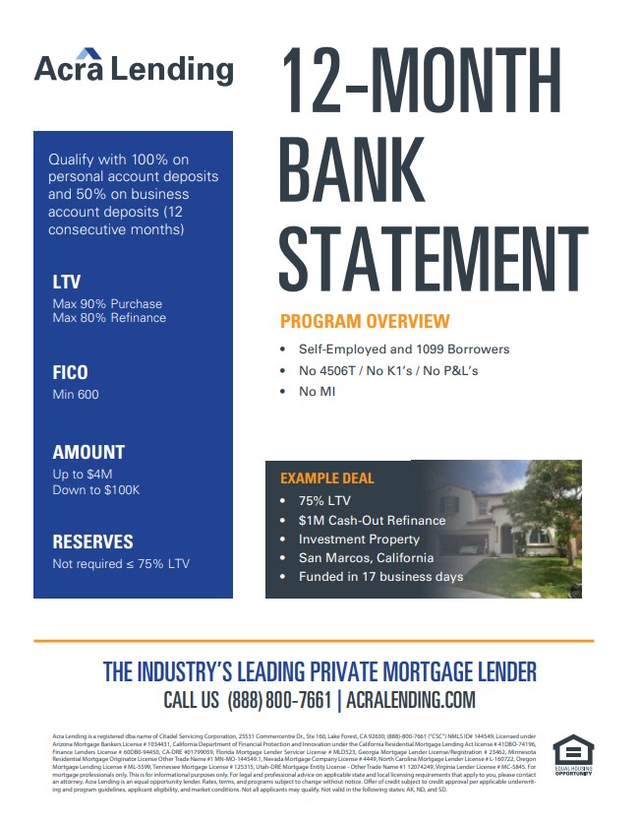
12-MONTH BANK STATEMENT
12 MONTH BANK STATEMENT
ATR-IN-FULL
Income documentation: Borrower’s most recent 12 months bank statements (No Tax Returns). Qualifying income is calculated using the 12-month deposit average
Qualify with a Personal Account or Business Account
Personal Account: Uses 100% of all deposits if the borrower uses a separate business account for business expenses
Business Account: Uses 50% of all deposits. If borrower’s business expense ratio is less that 50% and confirmed by the borrower’s CPA, we will allow down to 25% expense ratio
Program available up to 90% LTV with no MI
Loan Amounts to $10M
FICOs down to 600
No reserves required at 75% LTV and below
No 4506T / 1112s / K1s / P&Ls

Slide 8
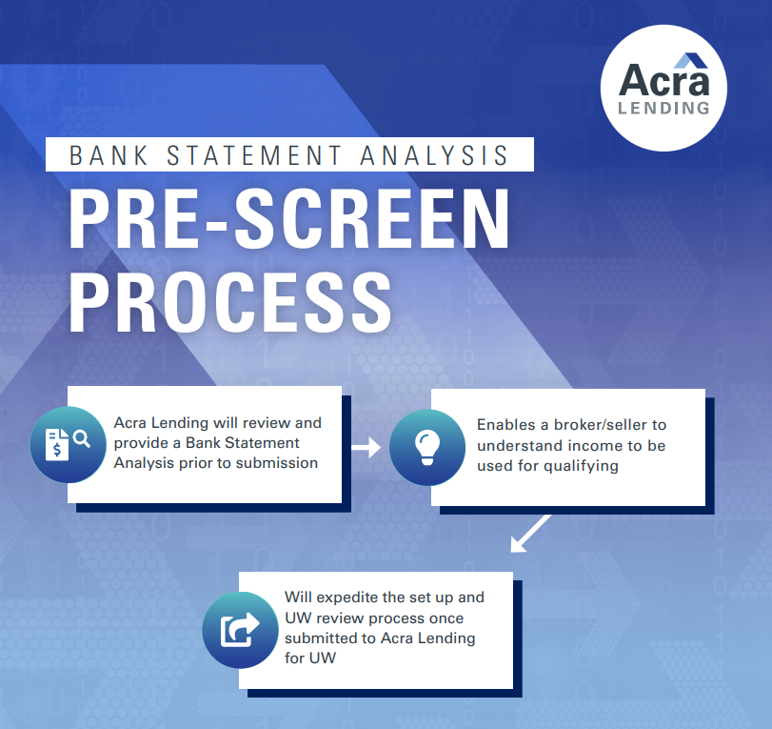
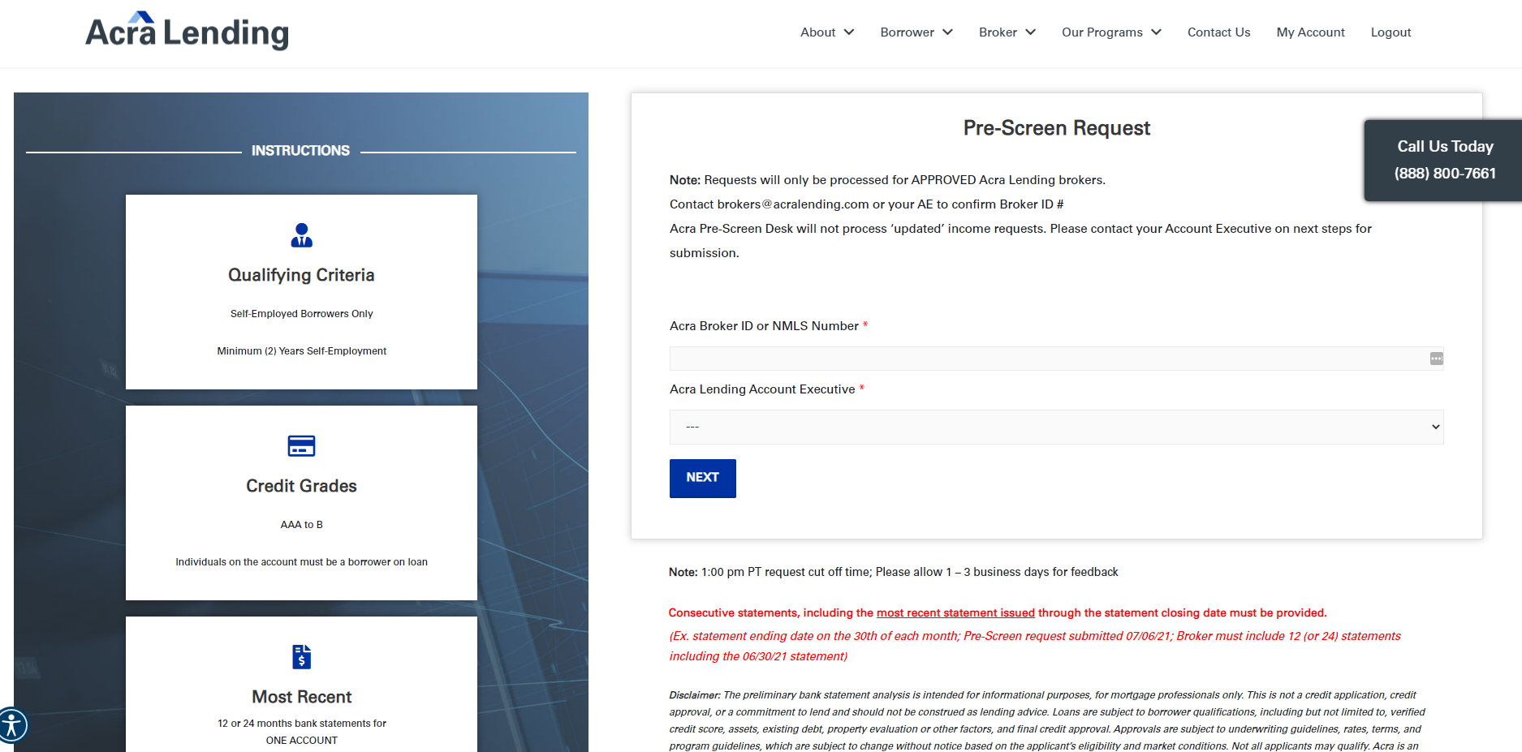
BANK STATEMENT ANALYSIS
BANK STATEMENT ANALYSIS
ATR-IN-FULL

Slide 9
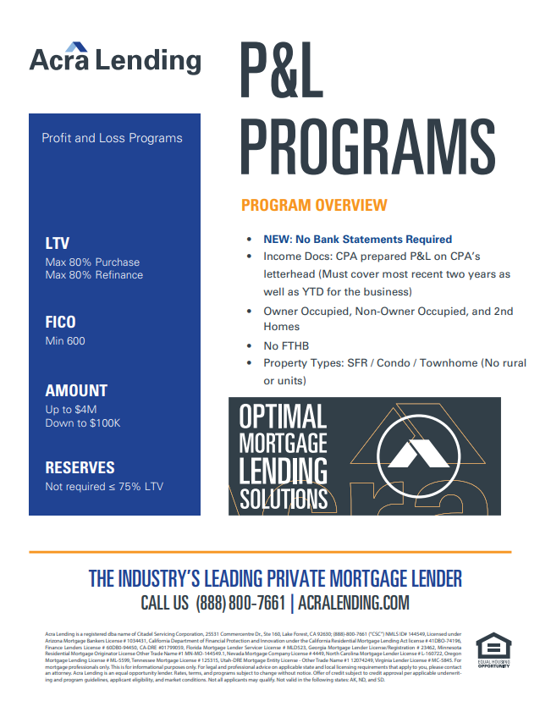
P&L PROGRAMS
Great option for SE borrowers who have a business expense ration below 25%
Income Docs: CPA prepared P&L covering previous two years and YTD (No Bank Statements). Qualifying income is calculated using the net profit on the P&L divided by the amount of months covered over the two year and YTD period
Excellent option for borrowers who operate as a ole proprietor and only use one bank account for both their business and personal expenses
Available up to 80% LTV
Down to a 600 FICO
Property Types: SFRs, Condos, Townhomes

Slide 10
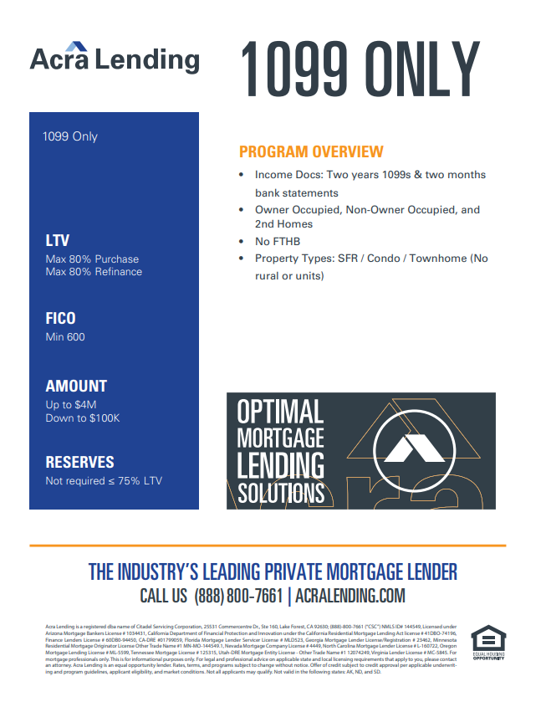
1099 ONLY
Designed for Independent Contractor borrowers on a 1099
Great option for 1099 borrowers who have a low business expense ratio and only use one bank account for both business and personal expenses
Income Docs: Most recent two years 1099s and most recent two months bank statements to show recent YTD deposits supporting 1099 income
Qualifying income is calculated by taking the average between the most recent two years 1099s and YTD to support
Excellent option for real estate agents, insurance agents, etc.
Available up to 80% LTV
FICOS down to 600
Property Types: SFRs, Condos, Townhomes

Slide 11
INVESTORS
We can do investment properties as Full Doc, Bank Statement, or DSCR loans
10+ financed properties is fine (our max is 20 but can go above on case by case)
Allowable property types include:
Short Term Rentals (AirBnB, VRBO)
Condotels
Adult Care Facilities
Sober Living Homes
Manufactured Homes

Slide 12
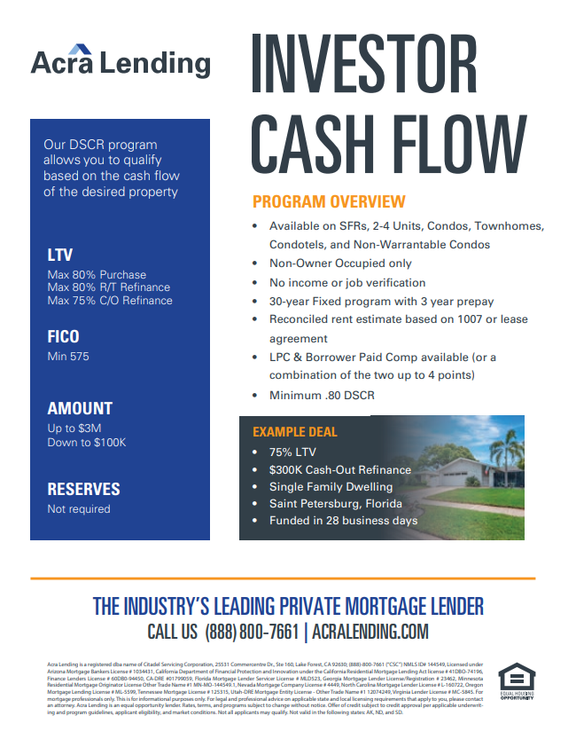
DSCR - INVESTOR CASH FLOW
INVESTOR CASH FLOW
ATR-IN-FULL
PROGRAM HIGHLIGHTS
Available on SFRs, 2-4 units, Condos, Townhomes, Condotels, and Non-Warrantable Condos
Max 80% LTV on Purchases and 75% LTV on Cash Out
The loan qualifies on fair market rents covering PITIA. Nothing else! No DTI
Up to $4M Loan Amounts
Non-Owner Occupied Only
No reserves required
No income or job verification
5yr/7yr ARM & 30-year fixed or 10 -ear IO 40-year term
Reconciled rent estimate based on 1007 or lease agreement
DSCR must be 1.00 (Down to .80 case by case)

Slide 13
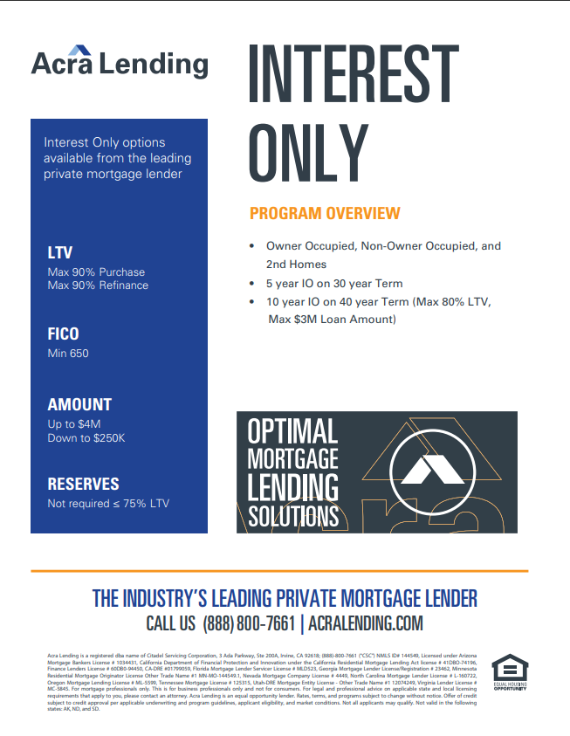
INTEREST ONLY
ATR-IN-FULL
PROGRAM HIGHLIGHTS
Down to 650 FICO
Owner-Occupied, Non-Owner Occupied, and 2nd Homes
Loan Amounts: $250K - $4M (O/O)
5-yr IO Available on 5/1 and 7/1 ARM
10-yr IO Available on 40-year Term
Max 85% LTV
Interest Only (5-yr) | 0.250% | 30-Term, Min Loan >$250K, Min FICO 650, Available on 5/1 or 7/1
Interest Only (10-yr) | 0.375% | Fixed Rate 40-Term, Min Loan >250K, Min FICO 650

Slide 14
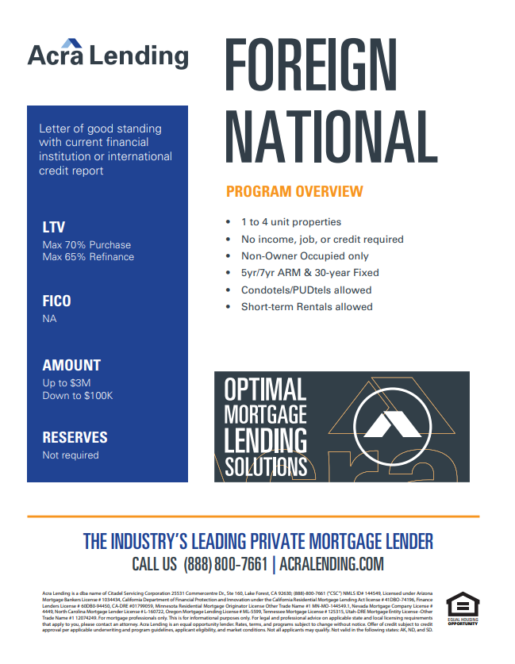
FOREIGN NATIONAL
FOREIGN NATIONAL
ATR-IN-FULL
Our Foreign National program is designed for borrowers who live and work outside of the U.S. and do not have US citizenship. This program is available for Foreign National borrowers to either purchase or refinance a NOO property
Qualifies using DSCR (No income or employment required)
No U.S. credit required
Up to 70% LTV Purchase and 65% LTV Refinance
Allows for DSCRs own to .80
No reserve requirements
Loan Amounts up to $3M
1-4 units, Condos, Townhomes, Condotels & Non-Warrantable Condos
Short-Term Rentals
I/O options available

Slide 15
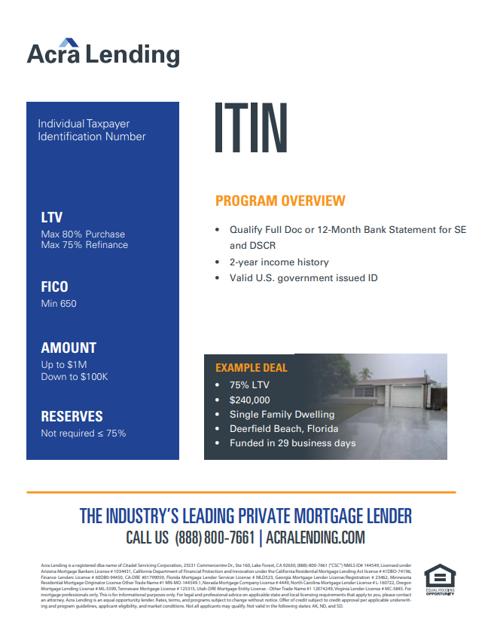
ITIN
PROGRAM HIGHLIGHTS
Qualify Full Doc or 12-Month Bank Statement for Self-Employed
Qualify with WVOE and 2 Months Bank Statements in lieu of W2
75% Max LTV Purchase or Refinance
No Reserves
2-year income history
Valid U.S. government issued ID & copy of ITIN document
Loan Amounts up to $1M
All gift from family members OK

Slide 16
NON-PERMANENT RESIDENT ALIENS
Non-Permanent Resident Aliens can qualify in any of our programs on all occupancies
Non-Permanent Resident Aliens should have an unexpired VISA and an EAD card
Can Structure as an ITIN borrower if missing either a VISA or EAD card
Up to 80% LTV
Most property types allowed
Loan Amounts up to $1M (greater allowed case-by-case)

Slide 17
QUESTIONS?
Let’s start with the first set of slides

