Slide 1
Expert Talks (New Technology)

Slide 2
Presenters
Introductions

Slide 3
Technology Impacts
What Does the Market Think?
How Can Technology Help?
One in four Mortgage providers has already made technology-based investments
Around 70% of Gen Z and 60% of Millennials prefer mobile based transaction capabilities
74% of Originators believe that technology simplifies the process
70% of Originators believe that technology can reduce the time to close
Making existing processes more effective and transparent
Improve communication
API multiple systems to create cleaner interconnectivity
Providing more tools and data elements to enhance the overall experience
What Are the Benefits?
What Are the Risks?
A reduction in manual errors
Simpler risk evaluation
Lower operational costs
Automated collection of documents
Streamlined review process
The ability to make quick lending decisions
An over subscription to the utilization of technology
FinTech Companies lack of business workflow or regulation
Rule based robotics or AI not accounting for the ability to create exceptions
Software Security

Slide 4
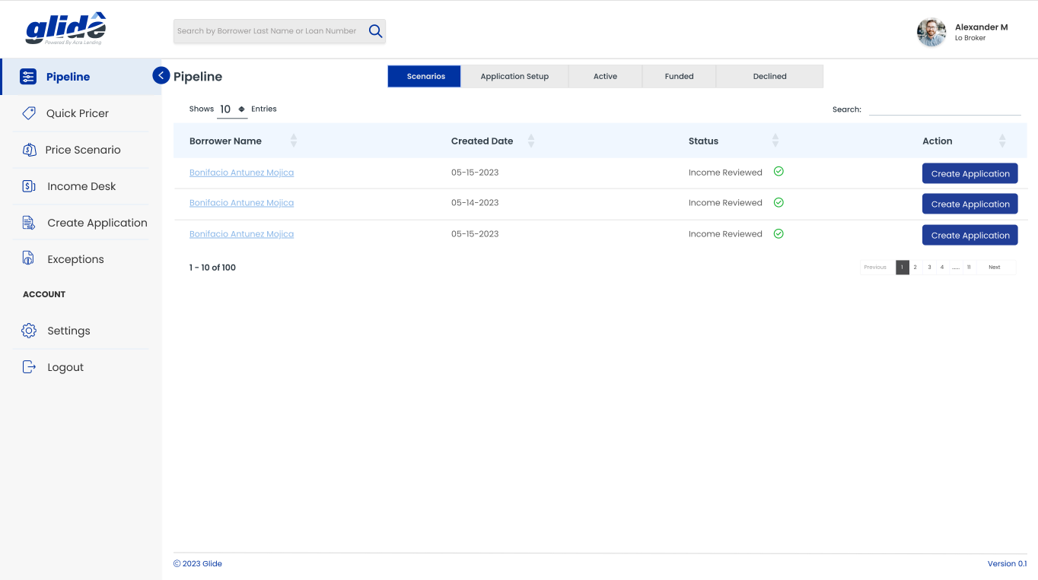
What is Acra’s Approach
Acra is releasing the GLIDE portal which will be a central hub for our brokers to view our completely redesigned backend system. This will be a clean and simple approach to enable a broker to; Price Loans, Calculate Income, Save Scenarios, Create Applications, Upload Conditions, and Submit Exceptions
Features Upon Launch
Pipeline: View your full pipeline of loans in any stage
Pricing: Quickly price or create scenarios to save
Income Calc: Submit bank statements to be analyzed to determine borrowers qualifying income
Create Applications: Submit loans directly to Acra Lending
Exceptions: Submit loans directly to Acra Deal Desk that would need guideline or rate exceptions
Communicate: Directly communicate with Acra during the UW process to fulfill or receive clarity on conditions
Transparency: View the status and stage of your in-process loans as well as obtain documentation and have visibility into critical disclosures

Slide 5
What to Expect
“A Hockey Team Is Like a Puzzle. Every Piece Is Vital ~ Bob Hartley (NHL Hockey Coach)
White Label Portal
NonQM AUS
A Customized White Label Portal a broker can share with their borrower to assist in the process.
A Decision engine added to the portal that will quickly pre-qualify a potential NonQM Loan
Disclosure Capability
Creation of workflows that will allow brokers to create and send their own disclosures
Chat Features
One Stop Shop
Chat Feature add on to digitally chat with Acra on loan specifics, guideline questions, or scenarios
Access to Data and Credit modules that can help assist in loan creation as well as ability to order services

Slide 6
Questions
THANK YOU FOR YOUR TIME TODAY AND FEEL FREE TO ASK QUESTIONS

