Slide 1

THE LEADER IN TODAY’S NON-QM PROGRAMS

Slide 2
INVESTMENT PROPERTY LENDING

Slide 3


MEET THE TEAM
STEVE CUTTER
Senior Vice President
C: (714) 595-4114
E: steve.cutter@acralending.com
W: acralending.com
JEFF LEMIEUX
Managing Director, Investor Loans Division
C: (949) 264-0618
E: jeffrey.lemieux@acralending.com
W: acralending.com

Slide 4
CONTENTS
WHO IS ACRA LENDING?
WHY ACRA LENDING?
INVESTOR LOAN PROGRAMS
BECOME A PARTNER
QUESTIONS

Slide 5
WHO IS ACRA LENDING?
CSC formed as a sister company to service for First Street Financial, Inc
CSC re-enters the mortgage origination market, specializing in Non-QM loans
Funds managed by HPS Partners purchased CSC
CSC rebranded to Acra Lending
Exceeds $10B in Fundings
2003
2013
2020
2021
2023
KEY FACTS
LEADERSHIP
  Leadership team made up of industry professionals with over 40+ years of experience
  $10B+ in fundings to date
  $5B+ servicing portfolio
  Licensed in 40+ states
KEITH LIND CEO | KYLE GUNDERLOCK President & CRO | MIKE KOVAR CFO & Treasurer
GREGORY MEOLA Managing Director | JEFFREY LEMIEUX Managing Director | CRAIG TIMMINS Managing Director
ERIC FRIEDMAN Managing Director | SCOTT SPENCER Manager Director | ALICE BOUTWELL Managing Director

Slide 6
WHO IS ACRA LENDING?
Acra Lending is a dba of Citadel Servicing Corporation which was acquired by a large equity firm in February 2020
CEO, Keith Lind is a tenured trader of structed credit including ABS and mortgage assets
Acra’s leadership and institutional ownership has enabled the company to maintain liquidity through the challenging 2022 & 2023 market
        $1B+ in financing facilities with 7 providers
      In excess of $60M of cash on it balance sheet
      Acra maintains the same cash position on its balance sheet as it did in Q4 2021
Why partner with Acra Lending? Acra offers originators and investors the opportunity to partner with the best capitalized private lender with the broadest loan program offering in the country

Slide 7
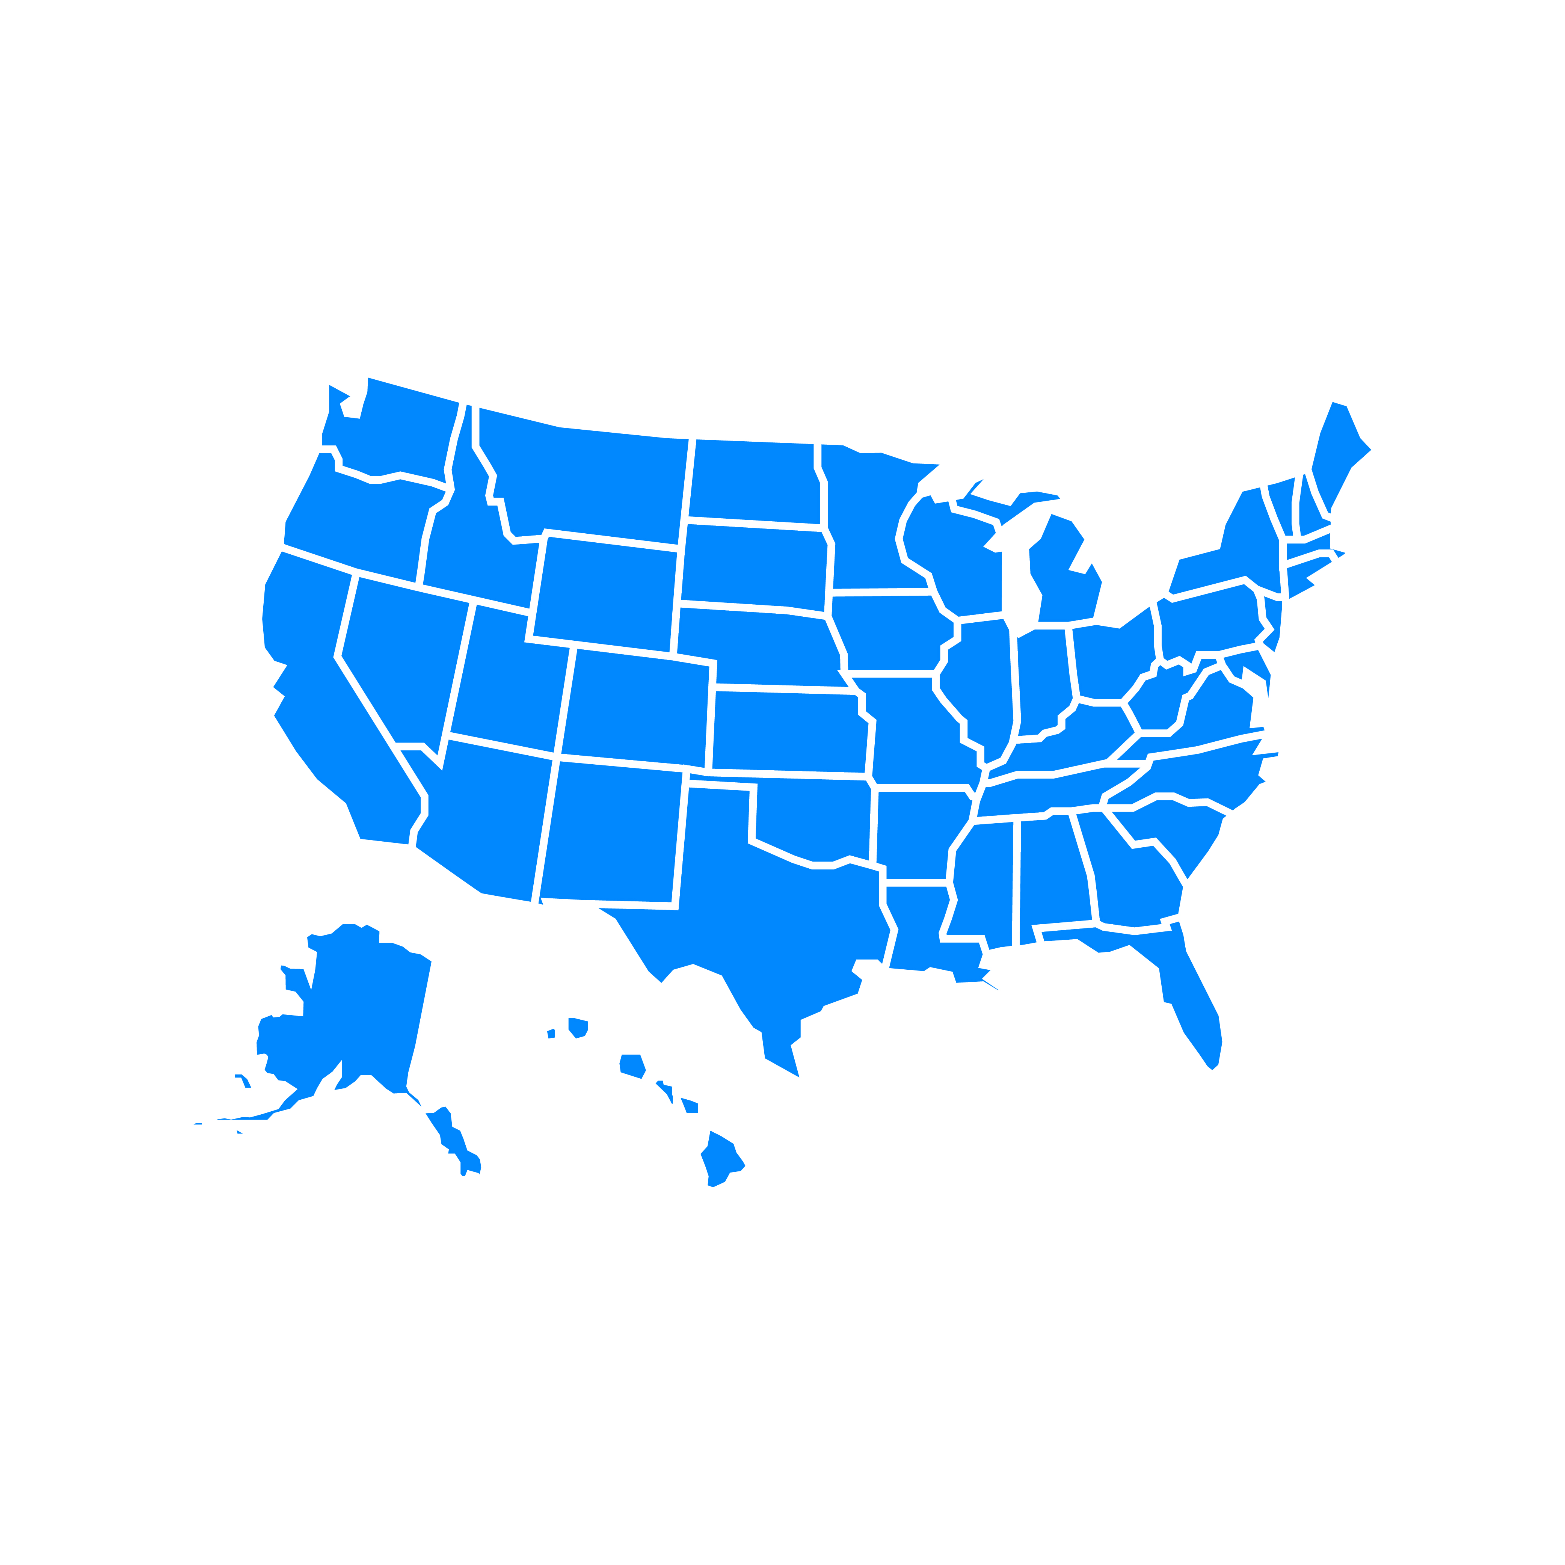
NATIONAL PRESENCE WITH LOCAL SERVICE
Clackamas, OR
West Hartford, CT
Lehi, UT
Las Vegas, NV
Missouri, MO
Corporate HQ in Orange County, CA
Scottsdale, AZ
Atlanta, GA
Clearwater, FL
Honolulu, HI
Ability to grow your business nationally. Business Purpose Loans in 32 states that do not require licensure

Slide 8
INVESTOR LOAN PROGRAMS
Non-TRID. There include Real Estate loans made to borrowers whereby the property is utilized for a business purpose
DSCR 1 – 4 units
Bridge 1 – 29 nits (no-rehab)
Multi-Family 5 – 24 units (long term)
Bridge 1 – 29 units (rehab)
Note 1: All Acra Investor Loans must be to entities and not to individual borrowers
Note 2: All Acra Investor Loans must be to on-owner occupied
Note 3: All Acra Investor Loans are Non-TRID due to the property being for a business purpose

Slide 9
BROKER LICENSING & REFERRAL FEE MATRIX

Slide 10
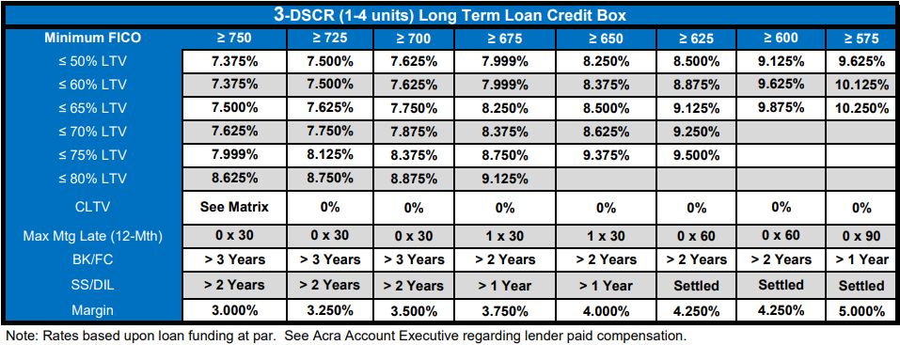
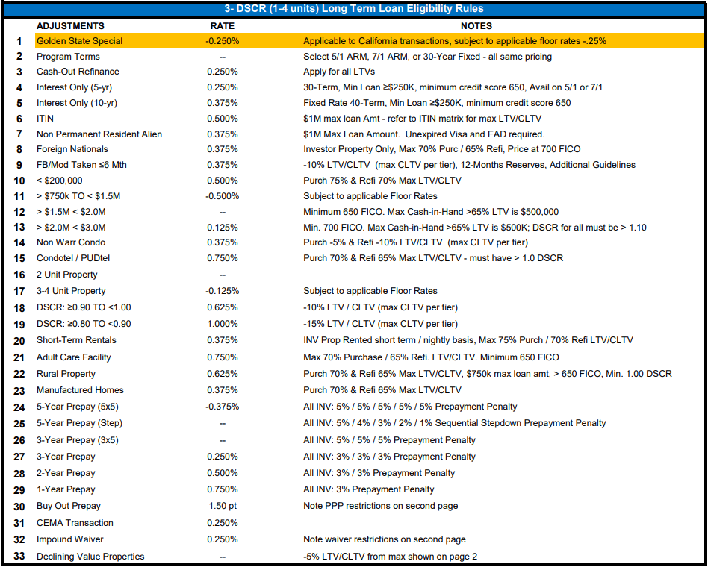
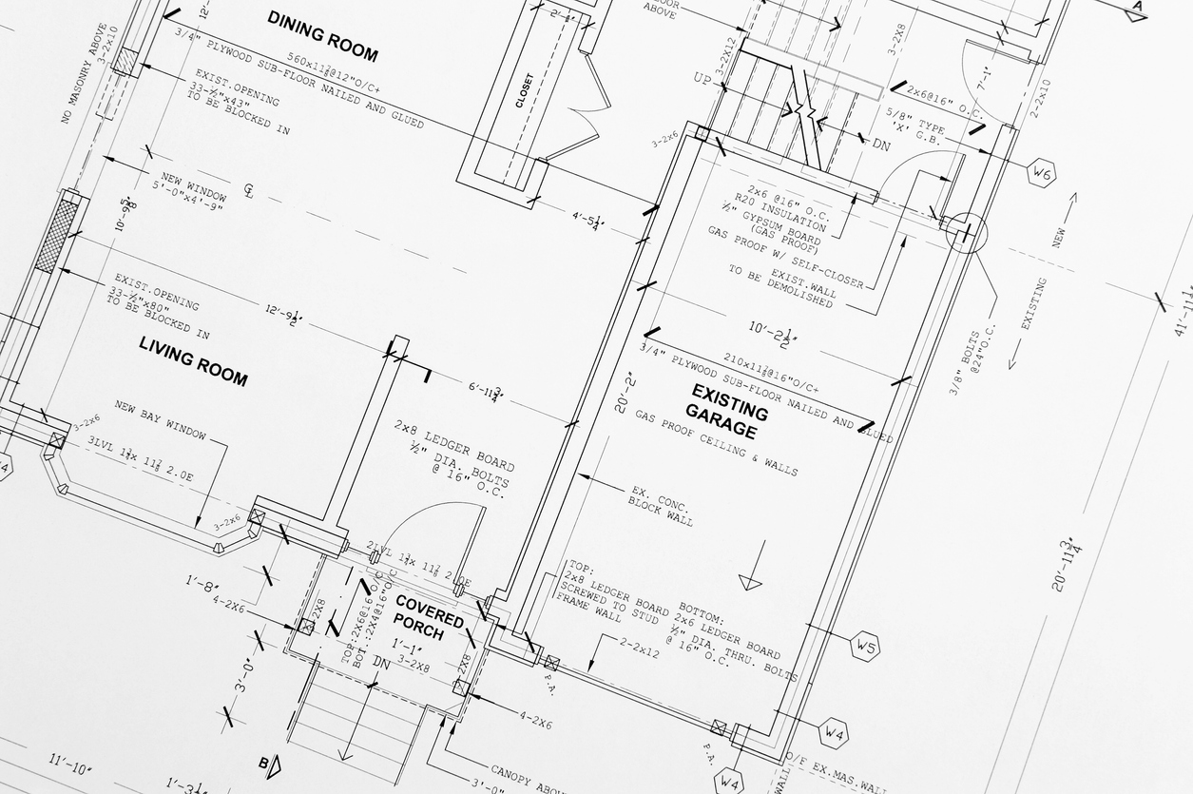
DSCR 1 - 4 UNITS
Effective Date: 05/25/23

Slide 11
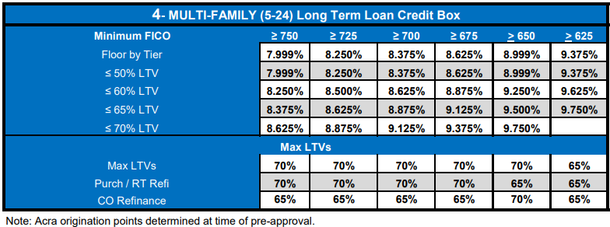
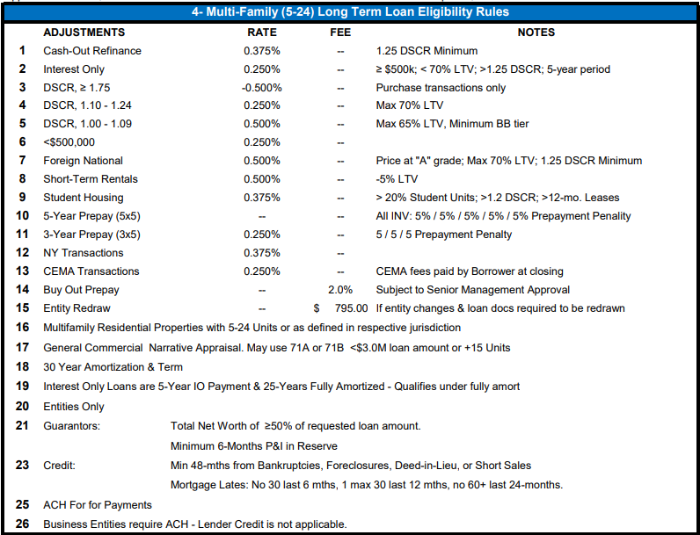
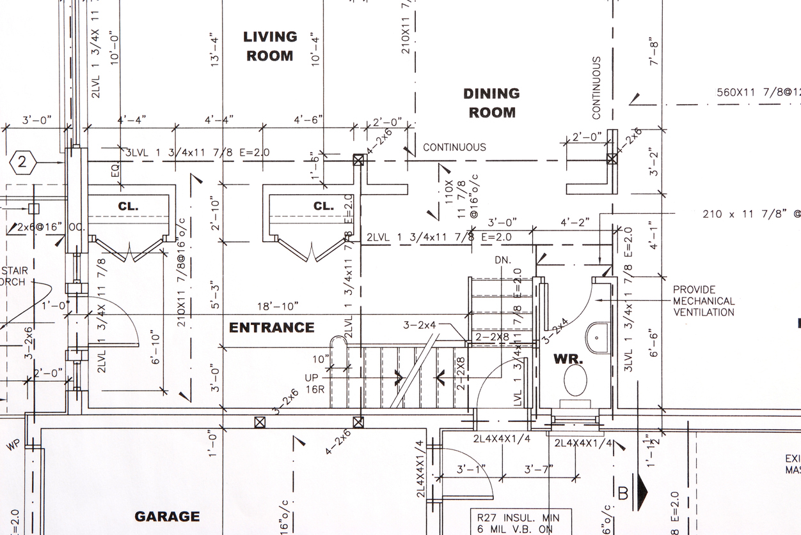
MULTI-FAMILY 5 - 24 UNITS (LONG TERM)
Effective Date: 05/25/23

Slide 12
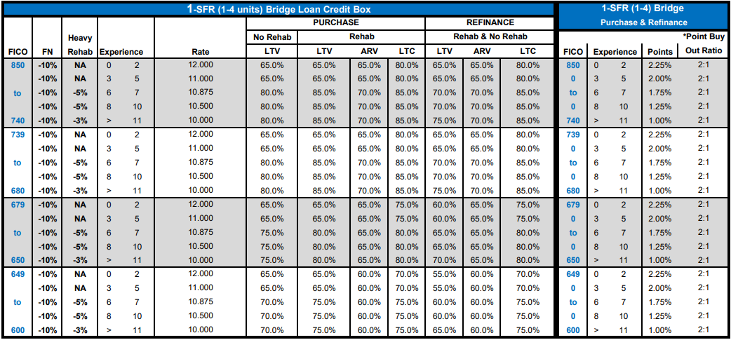

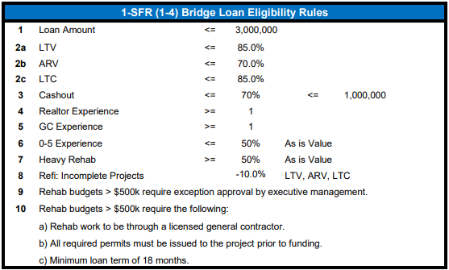
BRIDGE 1 - 4 UNITS
Effective Date: 05/25/23
Note: 0-5 experience tiers require 6 months of payment reserves on all transaction types, 6 and greater experience tiers require 6 months payment reserves on refinance transactions only

Slide 13
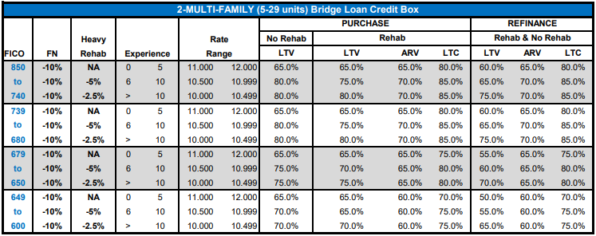
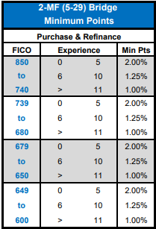
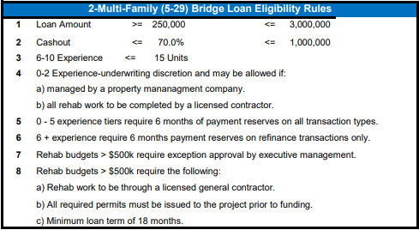
BRIDGE 5 - 29 UNITS
Effective Date: 05/25/23
Note: 0-5 experience tiers require 6 months of payment reserves on all transaction types, 6 and greater experience tiers require 6 months payment reserves on refinance transactions only

Slide 14
ILD LOAN PROCESS SUMMARY
LOAN SUBMISSION
LOAN SETUP
LOAN PROCESSING
1. Loan uploaded to ILD Submission Portal.
2. Loan reviewed by Salesperson to ensure meets submission requirements.
3. Loan Uploaded by Salesperson to “Submit to Setup” Box Folder.
4. Setup begins setting up loan.
1. Review for qualified submission.
2. Pull credit.
3. Order appraisal or appraisal review (link goes to borrower to secure payment).
4. Upon confirm of appraisal payment- setup orders:
- sitex, flood certificate.
5. Setup obtains borrower entity docs.
6. Upon all being completed – advance to processing.
Obtain:
1. Appraisal (reviews for issues- escalate).
2. Two forms of Gov’t ID.
3. Background check (reviews for issues-escalate).
4. Bank statements.
5. Title report (reviews for issues- escalate).
6. Hazard insurance.
LOAN PROCESSING
UNDERWRITING
PROCESSOR
1. Review for loan file completeness.
2. Resolve any outstanding issues that were escalated.
3. Review pricing relative to preapproval & reprice.
4. Upon all being completed- advance to underwriting
1. Complete underwriting and issue “Approval” to processor.
- If no conditions: Loan Approval “LA”
- If conditions: Conditional Loan Approval “CLA
1. Send approval to salesperson & borrower.
2. If no conditions advance to funding.
3. If conditions, obtain from borrower, review for accuracy and completeness.
4. Remit conditions to Underwriting.
UNDERWRITING
PROCESSOR
1. Review and clear conditions.
2. Send “LA” to processor.
1. Send “Loan Approval” to salesperson & borrower.
2. Advance to funding.

Slide 15
QUESTIONS?
Let’s start with the first set of slides

Slide 16

CONTACT US
STEVE CUTTER
Senior Vice President
C: (714) 595-4114
E: steve.cutter@acralending.com
W: acralending.com
JEFF LEMIEUX
Managing Director, Investor Loans Division
C: (949) 264-0618
E: jeffrey.lemieux@acralending.com
W: acralending.com
Acra Lending is a registered dba name of Citadel Servicing Corporation, 3 Ada Parkway, Ste 200A, Irvine, CA 92618; (888)-800-7661 (“CSC”) NMLS ID# 144549, Licensed under Arizona Mortgage Bankers License # 1034431, California Department of Financial Protection and Innovation under the California Residential Mortgage Lending Act license # 41DBO-74196, Finance Lenders License # 60DB0-94450, CA-DRE #01799059, Florida Mortgage Lender Servicer License # MLD523, Georgia Mortgage Lender License/Registration # 23462, Minnesota Residential Mortgage Originator License Other Trade Name #1 MN-MO-144549.1, Nevada Mortgage Company License # 4449, North Carolina Mortgage Lender License # L-160722, Oregon Mortgage Lending License # ML-5599, Tennessee Mortgage License # 125315, Utah-DRE Mortgage Entity License - Other Trade Name #1 12074249, Virginia Lender License # MC-5845. For mortgage professionals only. This is for business professionals only and not for consumers. For legal and professional advice on applicable state and local licensing requirements that apply to you, please contact an attorney. Acra Lending is an equal opportunity lender. Rates, terms, and programs subject to change without notice. Oer of credit subject to credit approval per applicable underwriting and program guidelines, applicant eligibility, and market conditions. Not all applicants may qualify. Not valid in the following states: AK, ND, and SD

