Slide 1
THE LEADER IN TODAY’S NON-QM PROGRAMS
acralending.com

Slide 2
NICHE PRODUCTS
acralending.com

Slide 3
MEET THE TEAM
acralending.com
STEVE CUTTER
Senior Vice President
c: (714) 595-4114
e: steve.cutter@acralending.com
JOE TOMASELLO
Senior Vice President
c: (559) 352-5156
e: joe.tomasello@acralending.com

Slide 4
CONTENTS
acralending.com
SCORES DOWN TO 575
$4M - $10M LOAN AMOUNTS
ONE SCORE/NO SCORE
CONDOTELS + NON-WARRANTABLE CONDOS
MIXED USED (51% RESIDENTIAL)
MANUFACTURED HOMES
MULTIFAMILY 5-24 Units
LOAN EXCEPTIONS
QUESTIONS

Slide 5
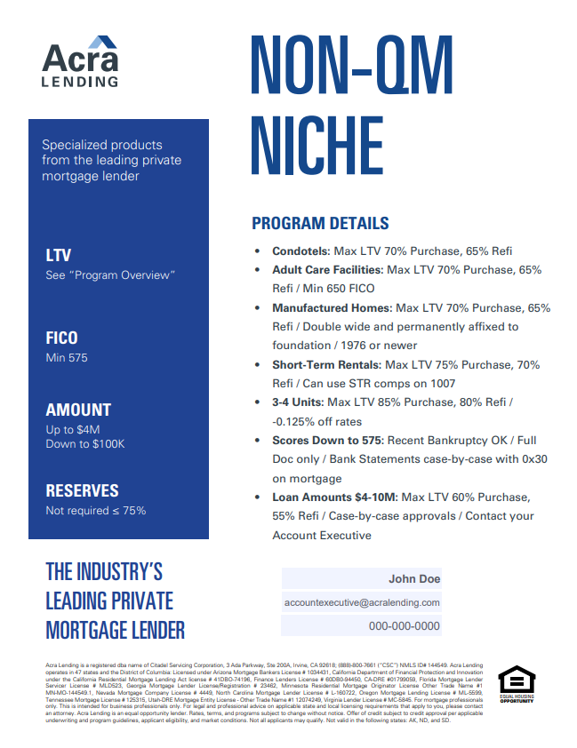
NICHE PRODUCTS
acralending.com
How is Acra Lending able to provide products that other Non-QM companies can’t?
Liquidity (Strong Balance Sheet)
Experienced and Highly Respected Management Team
Track Record ($10B+ Funded)
Superior Capital Partners
Strong Credit Team
Performance ($5B+ Servicing Portfolio – Low Delinquency)

Slide 6
SCORES DOWN TO 575
acralending.com
Specific Guidelines:
Maximum 65% Loan to Value Ratio
Available on Consumer and Business Purpose Loans
All Property Types Available
600 Minimum Score to Use Bank Statements (exception below 600 on case-by-case basis)

Slide 7
$4M - $10M LOAN AMOUNTS
acralending.com
Specific Guidelines:
Available on Owner Occupied, 2nd Home, and Investment Properties
Must Have Strong Credit and Assets
60% Maximum Loan to Value Ratio
Must be in Ares with High Medium Values

Slide 8
ONE SCORE / NO SCORE
acralending.com
Specific Guidelines:
Owner Occupied
Full Doc Only
Maximum 65% LTV
24 months housing history 0 x 30
No Score price as 700 score

Slide 9
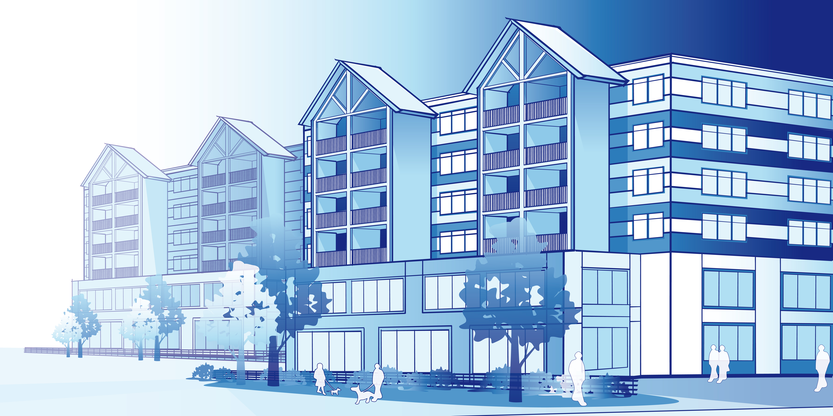
CONDOTELS & NON-WARRANTABLE CONDOS
acralending.com
Specific Guidelines:
Maximum 75% LTV Purchase and 65% LTV Refinance
Available on Consumer or Business Purpose Loans
Scores Down to 575
Minimum 1.0 DSCR required on Business Purpose
No Minimum Square Footage (must have kitchenette)

Slide 10
MIXED-USE PROPERTIES
acralending.com
Specific Guidelines:
Minimum 51% Residential
All Loans are Case by Case basis
Maximum 70% Loan to Value Ratio
No Companies Hazard Materials (Dry Cleaner, Automotive Repair)

Slide 11
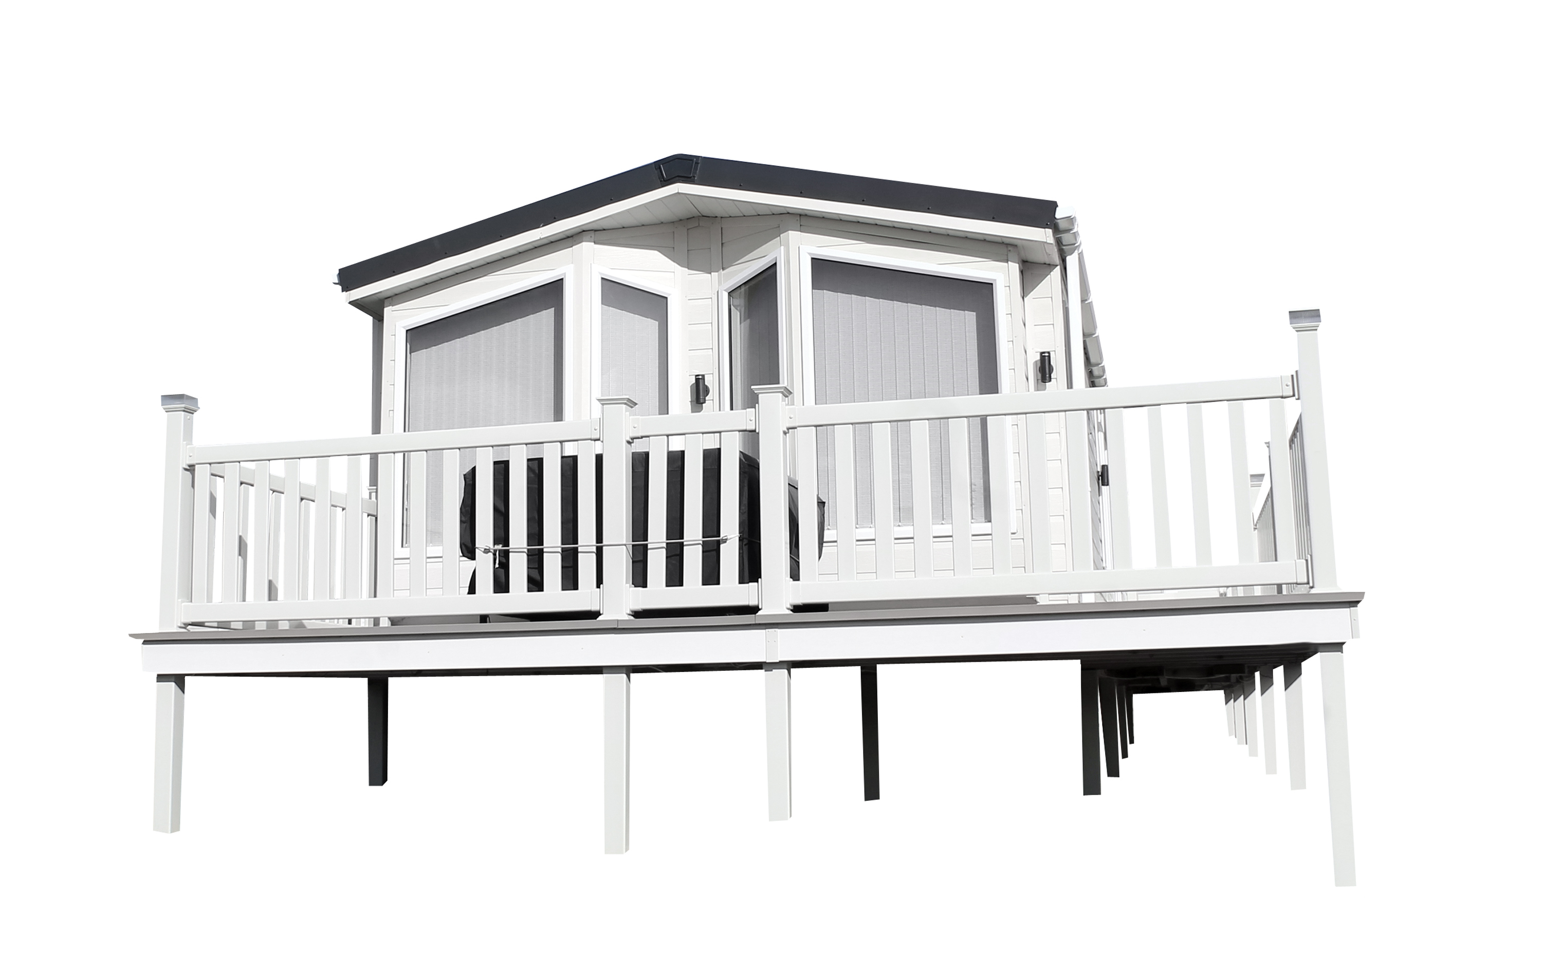
MANUFACTURED HOMES
acralending.com
Specific Guidelines:
Maximum 70% Purchase and 65% Refinance
Minimum 575 Score
Consumer or Business Purpose Loans
Must be Permanently Affiliated to Permanent Foundation
Must be Constructed After 1976
Must be at least Double Wide
No PUD’s allowed

Slide 12
MULTIFAMILY 5-24 UNITS
acralending.com
Specific Guidelines:
Qualifies solely off DSCR: Annual NOI / Annual PITI payment
Down to a 1.0 DSCR
Min Occupancy at closing 85%
70% LTV Purchase 65% LTV Refinance
I/O Option available
Only requires 6 months reserves

Slide 13
Exceptions to Guidelines
acralending.com
General Guidelines:
All Exceptions viewed on case-by-case basis
Compensating factors considered:
Loan To Value
Credit depth and high trades
Reserves
Pay shock
Cash flow of business or strength of income

Slide 14
QUESTIONS?
acralending.com
Let’s start with the first set of slides

Slide 15
CONTACT US
acralending.com
STEVE CUTTER
Senior Vice President
c: (714) 595-4114
e: steve.cutter@acralending.com
w: acralending.com
JOE TOMASELLO
Senior Vice Presidemt
c: (559) 352-5156
e: joe.tomasello@acralending.com
w: acralending.com
Acra Lending is a registered dba name of Citadel Servicing Corporation, 3 Ada Parkway, Ste 200A, Irvine, CA 92618; (888)-800-7661 (“CSC”) NMLS ID# 144549, Licensed under Arizona Mortgage Bankers License # 1034431, California Department of Financial Protection and Innovation under the California Residential Mortgage Lending Act license # 41DBO-74196, Finance Lenders License # 60DB0-94450, CA-DRE #01799059, Florida Mortgage Lender Servicer License # MLD523, Georgia Mortgage Lender License/Registration # 23462, Minnesota Residential Mortgage Originator License Other Trade Name #1 MN-MO-144549.1, Nevada Mortgage Company License # 4449, North Carolina Mortgage Lender License # L-160722, Oregon Mortgage Lending License # ML-5599, Tennessee Mortgage License # 125315, Utah-DRE Mortgage Entity License - Other Trade Name #1 12074249, Virginia Lender License # MC-5845. For mortgage professionals only. This is for business professionals only and not for consumers. For legal and professional advice on applicable state and local licensing requirements that apply to you, please contact an attorney. Acra Lending is an equal opportunity lender. Rates, terms, and programs subject to change without notice. Oer of credit subject to credit approval per applicable underwriting and program guidelines, applicant eligibility, and market conditions. Not all applicants may qualify. Not valid in the following states: AK, ND, and SD

