Slide 1
Webinar Recap
Industry’s Leading Private Mortgage Lender

Slide 2
Disclaimer
Acra Lending is a registered dba name of Citadel Servicing Corporation, 3 Ada Parkway, Ste 200A, Irvine, CA 92618; (888)-800-7661 (“CSC”) NMLS ID 144549. Acra Lending operates in 41 states and the District of Columbia: Alabama Consumer Credit License # 22078, Arizona Mortgage Bankers License # 1034431, Arkansas Combination Mortgage Banker-Broker-Servicer License # 109106, Licensed by the Department of Business Oversight under the California Residential Mortgage Lending Act. California – Department of Financial Protection and Innovation Financing Law License # 60DBO94450, California – Department of Financial Protection and Innovation Residential Mortgage Lending Act License # 41DBO-74196, California - DRE Real Estate Corporation License Endorsement License # 01799059, Colorado Mortgage Company Registration, Connecticut Mortgage Lender License # ML-144549, Delaware Lender License # 20322, District of Columbia Mortgage Lender License # MLB144549, Florida Mortgage Lender Servicer License # MLD523, Georgia Mortgage Lender License/Registration # 23462, Hawaii Mortgage Loan Originator License # HI-144549, Idaho, Illinois Residential Mortgage License # MB.6761204, Indiana-DFI Mortgage Lending License # 30531, Kansas Mortgage Company License # MC.0025274, Kentucky Mortgage Company License # MC327787, Louisiana Residential Mortgage Lending License, Maine Supervised Lender License # 144549, Maryland Mortgage Lender License # 144549, Michigan 1st Mortgage Broker/Lender/Servicer License # FL0020685, Minnesota Residential Mortgage Originator License Other Trade Name #1 MN-MO-144549.1, Missouri Mortgage Company License # 144549, Montana Mortgage Lender License # 144549, Nebraska Mortgage Banker License, Nevada Mortgage Company License # 4449, New Hampshire Mortgage Banker License # 21139-MB, New Jersey Residential Mortgage Lender License, New Mexico Mortgage Loan Company License, North Carolina Mortgage Lender License # L-160722, Ohio Residential Mortgage Lending Act Certificate of Registration RM.804651.000, Oklahoma Mortgage Lender License - Other Trade Name #1 ML013105, Oregon Mortgage Lending License # ML-5599, Pennsylvania Mortgage Lender License # 51804, South Carolina-BFI Mortgage Lender/Servicer License - Other Trade Name #1 MLS - 144549 OTN #1, Tennessee Mortgage License # 125315, Texas - SML Mortgage Company License, Utah-DRE Mortgage Entity License - Other Trade Name #1 12074249, Vermont Lender License - Other Trade Name #1 7601, Virginia Lender License # MC-5845, Washington Consumer Loan Company License # CL-144549, Wisconsin Mortgage Banker License # 144549BA, Wyoming Mortgage Lender/Broker License # 3781. This is intended for business professionals only. Acra Lending is an equal opportunity lender. Rates, terms, conditions, and programs are subject to change without notice. Offer of credit subject to credit approval per applicable underwriting and program guidelines, applicant eligibility, and market conditions. Not all applicants may qualify. Restrictions may apply. Not valid in the following states AK, IA, MA, MS, NY, ND, RI, SD, and WV

Slide 3
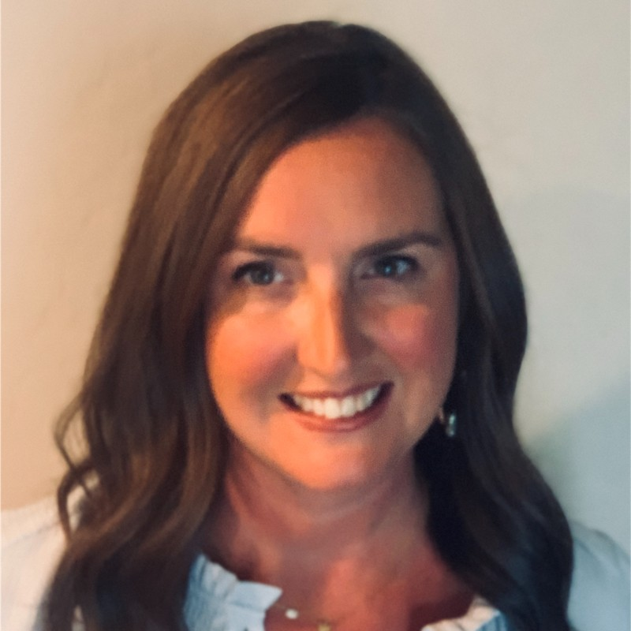
Meet The Team
Ryan Barrus
Senior Vice President
(801) 471-7926
Ryan.Barrus@acralending.com
Megan Willie
Senior Vice President
(612) 251-1239
Megan.willie@acralending.com

Slide 4
Table Of Contents
Program Overview
Niche Products
Sourcing Non-QM Business
New Technology

Slide 5
Program Overview

Slide 6
Self-Employed Borrowers
12-Month Bank Statements
Qualify with 100% on personal account deposits and 50% on business account deposits (12 consecutive months) *use lower expense ratio verified by CPA or licensed tax preparer
Loan amounts up to $4M (case-by-case $10M)
Max LTV 90% Purchase, 80% Refinance, Min 600 FICO
No reserves required at 75% LTV or below
No 4506T / No K1’s / No P&L’s / No MI
1099 Only and P&L
P&L Only: CPA prepared P&L covering most recent 1 year and YTD (No bank statements needed)
1099 Only: Most recent 1 year 1099s + Most recent 2 months Bank Statements for YTD
Max 80% LTV, Min 600 FICO, First-Time Home Buyers now allowed
No rural or multi-units
Min 24-month recent mortgage history

Slide 7
Investor Cash Flow
Qualify solely off subject property rents (Rents/PITI) - DSCR ratio down to .80
No Ratio DSCR option at 65% LTV max on purchase and 55% max LTV on refi
No income or employment verification
Available on SFRs, 2-4 Units, Condos, Townhomes, Condotels, and Non-Warrantable Condos
Loan amounts up to $3M
Investment properties only
No reserves required
5yr & 10yr I/O options available (Use I/O payment for DSCR ratio)
Purchases - Use the rent survey on appraisal for DSCR ratio

Slide 8
ATR-In-Full
Qualify with a liquid asset that is equal to or greater than the requested loan amount
Borrower does not have to be currently employed
Only show 2 months of statements for qualifying account (Brokerage Accounts, Retirement Accounts, Savings, etc.)
Min 600 FICO
Max 75% LTV Purchase
Max 70% LTV Refinance
Owner-Occupied Only

Slide 9
Unique Borrowers
Foreign National
Designed for borrowers who live + work outside of the US looking to purchase or refi an investment property here
No reserves, income, job, or credit required
NOO Only, Qualify on DSCR, 30-Year Fixed, 5yr & 10yr I/O available
Max LTV 70% Purchase, 65% Refinance
Non-Permanent Resident Aliens
Can qualify in any of our programs on all occupancies
Should have an unexpired VISA and an EAD card (can structure as ITIN if missing either a VISA or EAD card)
Max 80% LTV, Loan Amounts up to $1M (greater allowed case-by-case)
ITIN
Income programs: WVOE, Bank Statement, DSCR
2-year income history, Valid government issued ID or Passport
Min 650 FICO, Max 80% LTV, Loan amounts up to $1M

Slide 10
One Score No Score
No Minimum Credit required
Full Doc & DSCR Only
Maximum 65% LTV
24 months housing history 0x30
No Score price as 700 score
No reserves required

Slide 11
Niche Products

Slide 12
Niches
Short-Term Rentals (DSCR)
Condotels
Non-Warrantable Condos
Interest Only options
Rural properties and up to 25 acres
Manufactured homes
Jumbo’s up to $10M
Borrowers with recent credit events (Foreclosure, Bankruptcy, Short Sale, Forbearance)
Min 575 FICO

Slide 13
Sourcing Non-QM Business

Slide 14
Sourcing Non-QM Loans
Direct clients or referral source opportunities for Non-QM consumer loans are:
Realtors
CPA’s / Tax Preparers
Wealth Advisors
Trust Attorneys
Title Reps
Contractors
Hard Money Lenders
Bank + Credit Union Turndowns
Insurance Brokers
Data Brokers / Lead Providers
Real Estate or Foreign Investor Groups
Self-Employed Trade Hubs

Slide 15
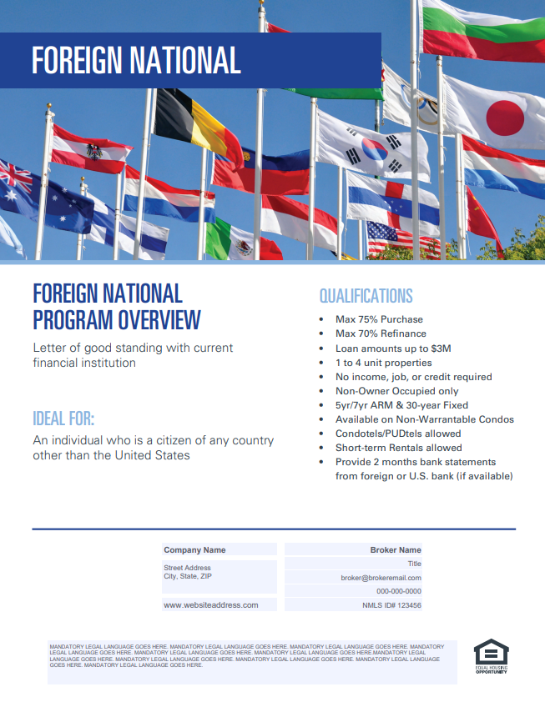
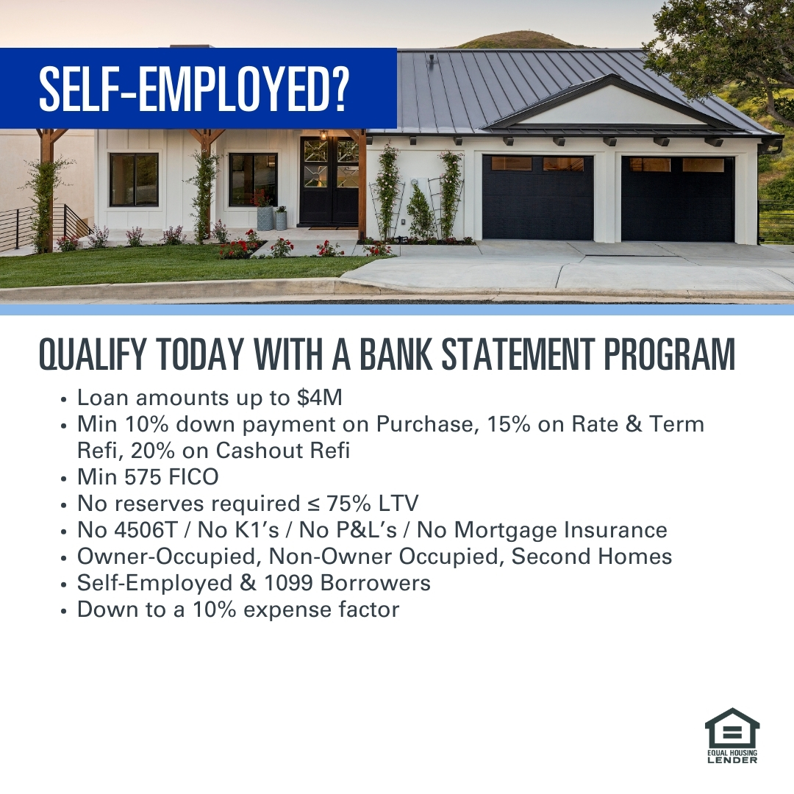
White Label Marketing
We offer customizable collateral available for approved brokers
Program and Product Flyers
Social Images
YOUR INFO
YOUR INFO

Slide 16
New Technology

Slide 17
Broker Portal

Slide 18
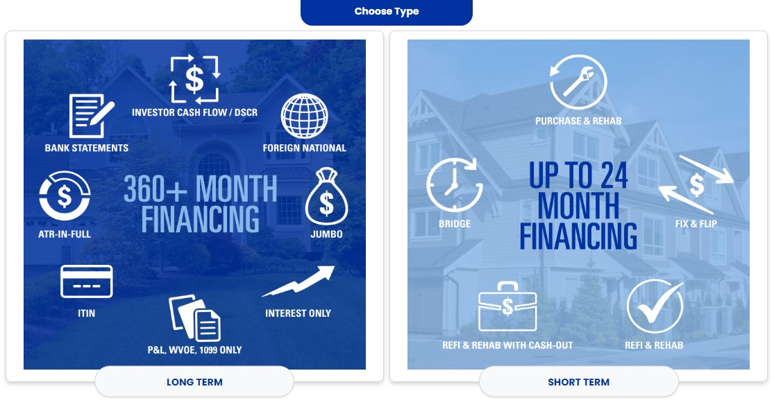
Broker Portal

Slide 19
Questions?

Slide 20
Contact Us!
Ryan Barrus
Senior Vice President
(801) 471-7926
Ryan.Barrus@acralending.com
Megan Willie
Senior Vice President
(612) 251-1239
Megan.willie@acralending.com

Slide 21
Thank You!

